Slide 1

IDI annual update
17th Performance Audit Subcommittee annual meeting
Maria Lucia Lima
24-25 March 2026
Budapest / Hungary

Slide 2

Ongoing or completed work
Professional Qualification and Certification
Sustainable Performance Audit Practices
IDI Global Public Goods
SoAQM
CCAA

Slide 3

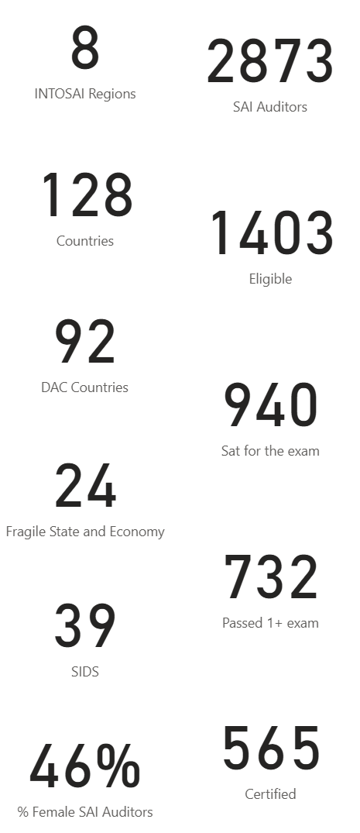
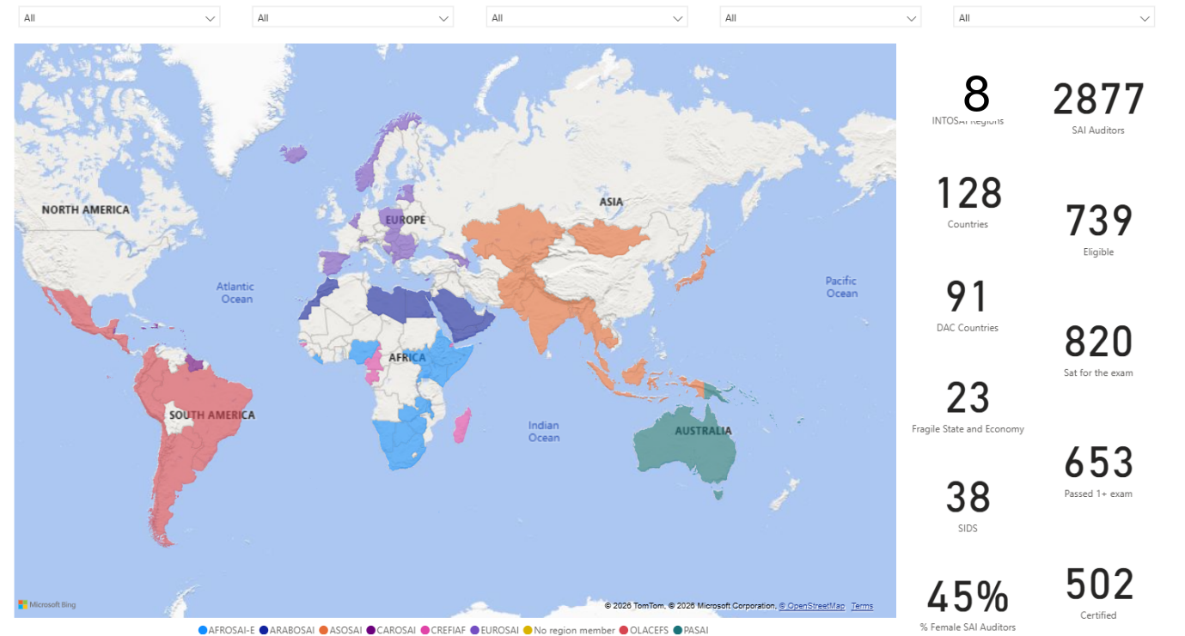
PESA
A professional qualification for SAI auditors
INTOSAI Branding
PESA Advisory Task Force of IDI Board
PESA Benchmarking study
PESA English, Spanish, Arabic (and French)
PESA Sandbox
INCOSAI motion recognising PESA

Slide 4
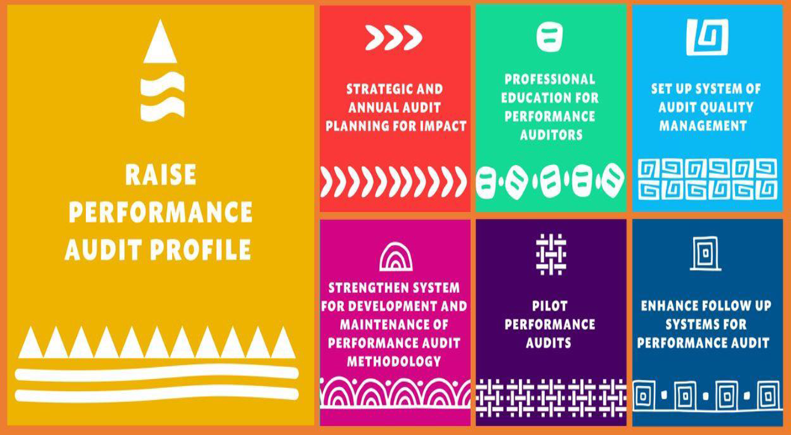
IDI-ADB Sustainable Performance Audit Practices (SPAP) SAI Level Support
Bangladesh
Bhutan
Mongolia
Nepal
Papua New Guinea
Phillipines

Slide 5
2025 achievements
Capacity development on AQM
SAIs have planned for SoAQM set up compliant with revised ISSAI 140
Model on how to measure effects created by SAI work
Participant SAIs strengthening their follow-up systems
Laddered 3-level Competency Framework for PA
IDI supported five SAIs in carrying out pilot audits

Slide 6
IDI Global Public Goods
Diagnostic tool (D-tool) (under development)
PA ISSAI Implementation Handbook
Laddered PA Competency Framework
Papers developed under the SPAP initiative
Materiality
Fraud risk
Documentation

Slide 7
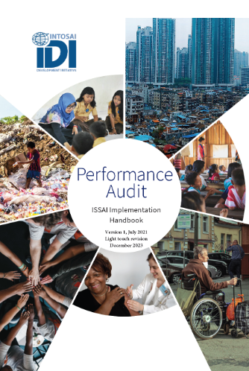
Light touch review
Update based on revised ISSAI 140
New appendices: Audit plan and Documentation
Editorial improvements

Slide 8
System of Audit Quality Management
More than 40 SAIs supported in SoAQM
SoAQM support for SAIs of Timor-Leste, Tunisia, Algeria
SoAQM Scale up in CAROSAI and ARABOSAI
SoAQM Playbook version 1 published
Support in OLACEFS and PASAI on going

Slide 9
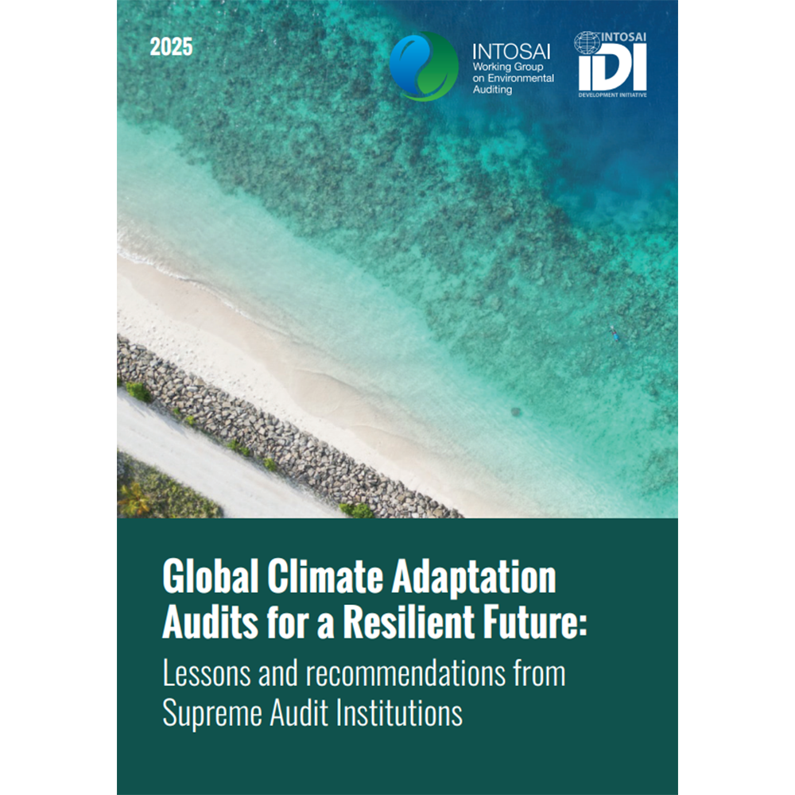
Global Cooperative Audit of Climate Change Adaptation Actions
54 SAIs (14 SIDS)
33 audit reports published so far
Themes
Adaptation planning and actions
Water resources management
Sea level rise and costal erosion
Implementation of climate change adaptation plans or actions (SDG 13)
Cross-cutting themes
Governance
Effectiveness
Inclusiveness

Slide 10

New initiatives
AQMS
AASuRe
SDGAI
Emerging issues
SAIs in SIDS
Audit Tech & AI

Slide 11

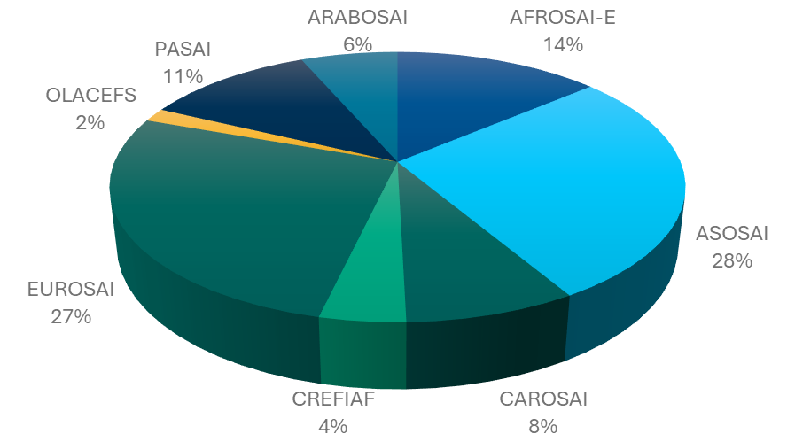



Audit Quality Management Specialist Certificate (Pilot)
Notes:
In English
2027 in Spanish

Slide 12

AUDIT TECH & AI
Professional Competency Development of SAI Auditor
SAI Leadership in Audit Tech & AI
Tech & AI competencies for every SAI auditor
Specialised competencies
Facilitate professional development of SAI Leaders in decision making related to tech and AI
Our Vision: A critical mass of SAI Auditors competent in the technology and artificial intelligence and the auditing of technology and artificial intelligence, contributing to sustainable audit practices.
Sustainable Audit Practices
Coalition of Stakeholder for Audit Tech & AI
Global Cooperative Performance Audits on Cybersecurity Governance
Build a CoS and Network
Support country level stakeholder engagement
Notes:
CoS – Coalition of Stakeholder

Slide 13
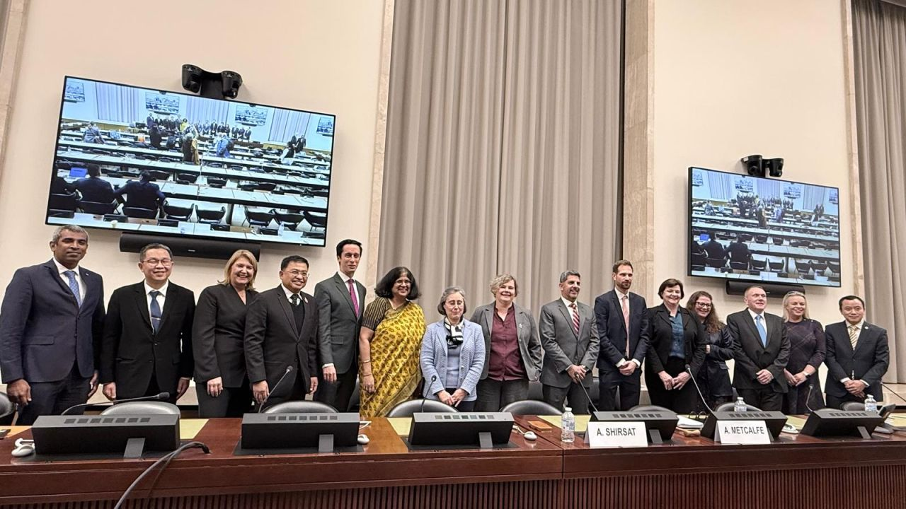
AASuRe Audit and Assurance of Sustainability Reporting in the Public Sector
Build coalition of stakeholders for AASuRe
Design AASuRe
Develop audit and assurance framework for sustainability reporting in the public sector
Announced at UNCTAD IDI pre 42nd ISAR event in November 2025
Notes:
Deirdre and Alain in the picture.
UNCTAD – UN Trade and Development
ISAR – International Standards of Accounting and Reporting. Intergovernmental Working Group dedicated to assists member States to improving quality and international comparability of financial reporting and non/financial disclusure, such as environmental issues, corporate governance and corporate social responsibility.

Slide 14
Proposed AASuRe Initiative Framework
VISION
Achieving high-quality, high-impact audit and assurance
of public sector sustainability reporting
[Slogan: Building public trust for a sustainable future]
Pillar 1
Pillar 2
Pillar 3
Assess AASuRe Landscape
Global Level – Develop AASuRe Diagnostic tool for external and internal scan of the landscape at country level.
Country-level pilots – Multi stakeholder teams for piloting AASuRe D-tool.
Audit and Assurance Framework
Global Level – Develop the audit and assurance framework to provide entry points, options and methodological guidance for SAIs.
SAI Level pilots – Support SAIs in piloting the audit framework at the country level.
Professional Competence Development
SAI Auditor Competence framework
Professional pathways for developing auditor competence
AASuRe Professional Education
AASuRe Certificate
Global level – SAI level
Pillar 4: AASuRe Ecosystem to build public trust
Awareness and Advocacy
Shaping Audit Practice
Partnerships for Delivery

Slide 15


SAI SDG Auditor Initiative
42 SAIs
7 INTOSAI regions
SDG@idi.no

Slide 16
Key outcomes
COMPETENCE
Grow competent SAI SDG auditors to audit sustainability and SDGs, including policy coherence and LNOB
CONTRIBUTION
to SDG implementation through high-quality, high-impact performance audit of processes for SDG implementation
COMMUNICATION
for greater audit impact, visibility and demonstrated audit value
Leave No One Behind (LNOB)
Notes:
Based on PA ISSAIs and on ISAM and the frameworks (Policy coherence and LNOB).

Slide 17
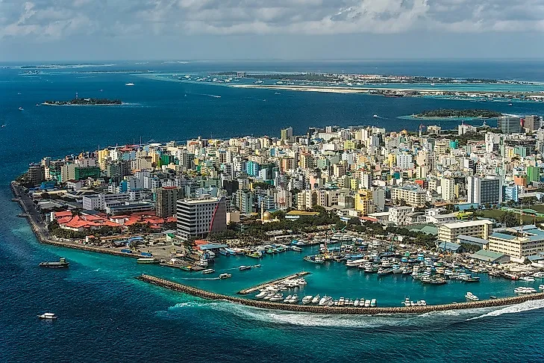

SAIs in SIDS
Build a SIDS perspective across initiatives
SIDS Support Model of Cooperative Audits – CCAA, SAI SDG Auditor
SIDS Support Model for SoAQM
Global Summit on SIDS, May 2026, Maldives

Slide 18
PASAI SDG framework at SDG Auditor Initiative
Audit objective
Are the relevant public authorities incentivizing the development and retention of skilled workers in country to support achievement of national SDG outcomes? ​
1) Have the public authorities put in place sound strategies for the development and retention of skilled workers in country?​
2) Have the public authorities effectively implemented the strategies for developing and retaining skilled workers in country?​
3) Are the strategies successfully developing and retaining skilled workers in country?

Slide 19
Emerging Issues
Audit of Public Debt Accountability
Auditing to fight corruption
Room to increase knowledge sharing with the evaluator´s Community

Slide 20
Questions?

