Slide 1
The IIA’s Artificial Intelligence
Auditing Framework
INTOSAI PAS
Budapest –
Annual Meeting
Kat Seeuws, CIA, CRMA, GCAP, CFE, CISA
Vice President
Standards & Guidance, The IIA Global HQ

Slide 2

Katleen Seeuws CIA, CGAP, CRMA, CFE, CISA
Vice President, Standards & Guidance
The Institute of Internal Auditors, Global Headquarters
Previously CEO of IIA Belgium
Extensive experience in internal control and audit, especially in public sector
Began career as tax inspector, later advising on internal control development for Belgian federal government
Joined European Commission in 2018 as national expert, supporting Public Internal Control Network
Consulted for Grant Thornton, focusing on audit and quality assessment for public sector clients
International work includes projects with European Commission, OECD, and World Bank, advancing public administration reform

Slide 3
Agenda
AI, IA, and The IIA
Context
Part 1: The AI Framework: Overview
Part 2: Getting Started
Part 3: The AI Framework:
  Governance
  Management
  Internal Audit
Part 4: Practitioner’s Guide and Glossary
What the Future Holds
Discussion

Slide 4
AI, IA, and The IIA

Slide 5
Why AI Matters to Internal Auditing
AI adoption is accelerating on a global scale
Assurance expectations are increasing
Stakeholders seek trust and confidence
AI is embedded in critical decisions
©2026, The Institute of Internal Auditors. All rights reserved. For individual personal use only

Slide 6
The Role of AI and Internal Auditing
To prioritize for independent assurance
As an internal audit a tool
To assess governance, risk management, and control
As a risk area in audit planning
©2026, The Institute of Internal Auditors. All rights reserved. For individual personal use only

Slide 7
Quote
“The future of AI is not about replacing humans,
it’s about augmenting human capabilities.”
Sundar Pichai - CEO of Google
©2026, The Institute of Internal Auditors. All rights reserved. For individual personal use only

Slide 8
The IIA’s AI Auditing Framework: Context

Slide 9
The IIA’s AI Auditing Framework: Context
Original version of Framework published in 2017-2018
Update to enhance relevance with examples of current usage
Purpose: to help CAEs and internal auditors
  Understand AI risks
  Recognize best practices in AI GRC
  Identify appropriate evaluation criteria
  Enable relevant and meaningful assurance and advice
Can be used to facilitate discussions with management and the audit committee to determine how internal auditing can be a resource
©2026, The Institute of Internal Auditors. All rights reserved. For individual personal use only

Slide 10
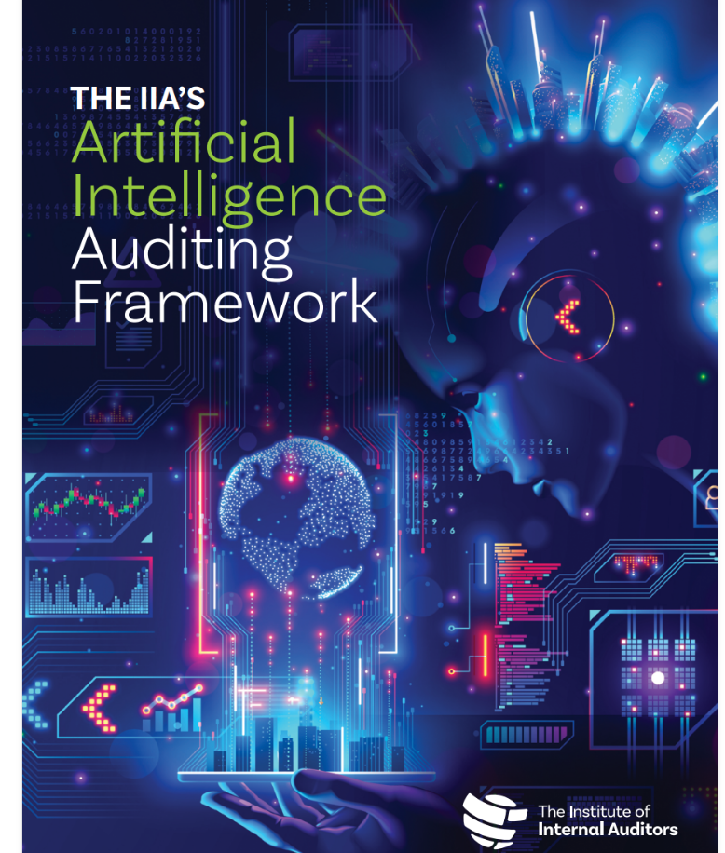
The IIA’s AI Auditing Framework: Context
Authored from the internal auditor’s perspective:
What is AI, and what do I need to know?
How do I develop an understanding of AI?
How do I leverage my current knowledge?
What are the risks and mitigating controls?
How can I be a resource to my organization?
©2026, The Institute of Internal Auditors. All rights reserved. For individual personal use only

Slide 11
The IIA’s AI Auditing Framework: Context
Developed through a structured, multi‑stakeholder process
Updated Framework organized into four parts:
  Overview
  Getting Started
  AI Auditing Framework
    Governance
    Management
    Internal Audit
  Practitioner’s Guide and Glossary
©2026, The Institute of Internal Auditors. All rights reserved. For individual personal use only

Slide 12
Part 1: Overview

Slide 13
To develop baseline understanding
History and evolution of AI
Adoption levels
AI types
Generative AI has received much attention over the past year
  Examples: ChatGPT, Bard (Google), Watsonx (IBM)
AI evolution – from analytical (machine learning) to creative solutions
©2026, The Institute of Internal Auditors. All rights reserved. For individual personal use only

Slide 14
Examples of AI-related risks
  Presents new risks and challenges for organizations to manage
  Bias
  Hallucinations
  Financial harm
  Environmental harm
  Misinformation/manipulation
  Copyright infringement
  Compromised privacy/confidentiality
©2026, The Institute of Internal Auditors. All rights reserved. For individual personal use only

Slide 15
The AI “Black Box”
Challenges:
  Lack of transparency
  Difficult to understand complex processing
  Limited visibility into the technical aspects of algorithms/deep learning models
  Capabilities are increasing at a rapid pace
©2026, The Institute of Internal Auditors. All rights reserved. For individual personal use only

Slide 16
Part 2: Getting Started

Slide 17
Engaging the Organization
Researching and analyzing internal information
Discussions to identify how AI is currently utilized and plans for future deployment
Understanding:
  How AI will be governed and managed
  Data is used and needed for AI
  Data protection and cybersecurity
©2026, The Institute of Internal Auditors. All rights reserved. For individual personal use only

Slide 18
Data Requirements
Data is the fuel for Artificial Intelligence
Some considerations for AI-related data:
  What data is being used?
  What is the origin of the data?
  How do we know the data is complete, accurate, reliable, valid?
  Who has access to the data?
  How do we protect the data?
Important aspect related to data protection/cybersecurity
©2026, The Institute of Internal Auditors. All rights reserved. For individual personal use only

Slide 19
Part 3: The AI Auditing Framework

Slide 20
AI Auditing Framework: Three Domains
Three domains:
  Governance: AI oversight and strategy
  Management: AI planning and application, including managing risks and controls
  Internal Audit: independent assurance and advice
Linked with the Three Lines Model
©2026, The Institute of Internal Auditors. All rights reserved. For individual personal use only

Slide 21
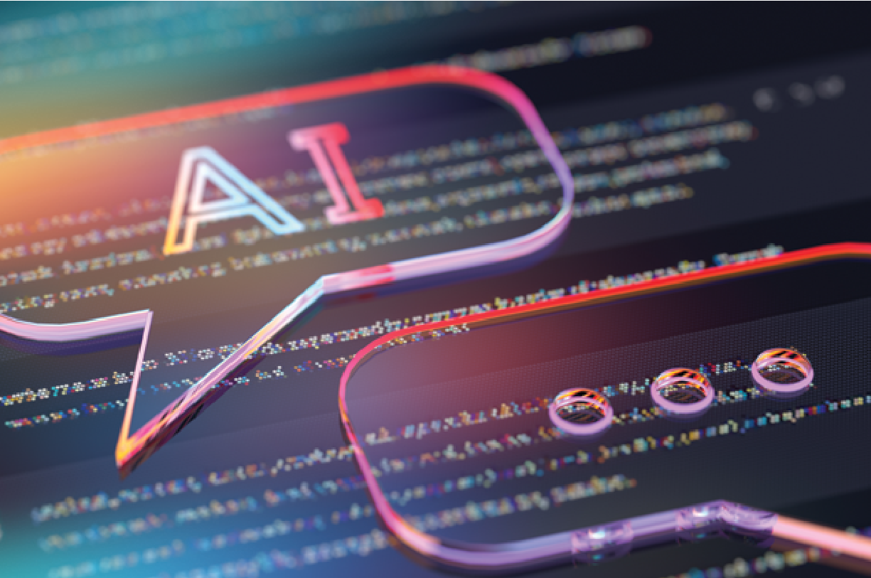
AI Auditing Framework: Governance

Slide 22
AI Auditing Framework: Governance
Governance expectations:
Clear accountability and oversight
Alignment with strategy, purpose, and values
Risk-based governance across the AI lifecycle
Ethical, responsible, and prevention of harm
Policies, standards, and operationalization
Monitoring, assurance, and continuous improvement
©2026, The Institute of Internal Auditors. All rights reserved. For individual personal use only

Slide 23
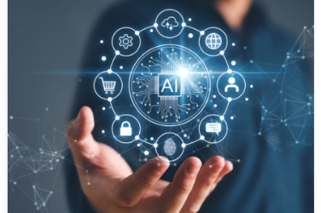
AI Auditing Framework: Management

Slide 24
AI Auditing Framework: Management
Management responsibilities include:
  Data integrity and data governance
  User access
  Cybersecurity
  System development lifecycle
  Change management
  Back-up/recovery controls
©2026, The Institute of Internal Auditors. All rights reserved. For individual personal use only

Slide 25

AI Auditing Framework: Internal Audit

Slide 26
AI Auditing Framework: Internal Audit
Auditor’s starting point:
  Risk-based scoping
  Understanding AI lifecycle
  Coordination with other assurance providers
Controls and assurance techniques:
  Preventive and detective controls
  Use of specialists
  Continuous auditing opportunities
©2026, The Institute of Internal Auditors. All rights reserved. For individual personal use only

Slide 27
AI Auditing Framework: Internal Audit
Auditing AI governance:
  Strategy and tone at the top
  Roles and responsibilities
  Alignment with objectives
Auditing AI lifecycle:
  Design and development
  Deployment and use
  Ongoing change and monitoring
©2026, The Institute of Internal Auditors. All rights reserved. For individual personal use only

Slide 28
Practitioner’s Guide

Slide 29
Practitioner’s Guide and Glossary
Checklist tool to get started with supporting Glossary
Summarizes key aspects from three domains
Used to assess how an organization approaches, uses, and reports on AI
Should be customized to fit organization
Applicable to both advisory and assurance applications
Helps communicate to stakeholders the role of internal auditing in AI
©2026, The Institute of Internal Auditors. All rights reserved. For individual personal use only

Slide 30

Practitioner’s Guide: Extract
©2026, The Institute of Internal Auditors. All rights reserved. For individual personal use only

Slide 31
What The Future Holds

Slide 32
Why AI auditing will continue to grow
Expanding AI use
Ever-increasing potential of AI for greater sophistication and autonomy (opportunities and threats)
Increased regulatory focus
Higher stakeholder expectations
©2026, The Institute of Internal Auditors. All rights reserved. For individual personal use only

Slide 33
Quote
“It is important for all auditors to continue to be aware of evolving regulations and established frameworks and identify and fill any gaps in their skills.”
Kavin Anburaj, Internal Audit Director –
Privacy and Legal Compliance, Meta
©2026, The Institute of Internal Auditors. All rights reserved. For individual personal use only

Slide 34
Coordination and Reliance
Collaboration between Internal Audit and Supreme Audit Institutions on AI Oversight
Shared understanding of AI risks
Leveraging complementary assurance roles
Coordinated assurance planning
Use and reliance on internal audit work
Strengthening AI governance across the public sector
©2026, The Institute of Internal Auditors. All rights reserved. For individual personal use only

Slide 35
Discussion
©2026, The Institute of Internal Auditors. All rights reserved. For individual personal use only.

Slide 36
Thank You!
For general IPPF questions, email Standards-Guidance@theiia.org
Follow me on LinkedIn:
Katleen Seeuws
©2026, The Institute of Internal Auditors. All rights reserved. For individual personal use only.

Slide 37
Copyright Notice
The Global Internal Audit Standards and related materials are protected by copyright law and are operated by The Institute of Internal Auditors, Inc. (“The IIA”). ©2026 The IIA. All rights reserved.
No part of the materials including branding, graphics, or logos, available in this publication may be copied, photocopied, reproduced, translated or reduced to any physical, electronic medium, or machine-readable form, in whole or in part, without specific permission from the Office of the General Counsel of The IIA, copyright@theiia.org. Distribution for commercial purposes is strictly prohibited.
For more information, please read our statement concerning copying, downloading and distribution of materials available on The IIA’s website at www.theiia.org/Copyright.

