Slide 1


Professional Standards Committee update
17th annual INTOSAI Performance Audit Sub-committee meeting
Alan Findlay, INTOSAI Professional Standards Committee
European Court of Auditors, Luxembourg
24-25 March 2026

Slide 2


PSC consolidated
workplan
Projects grouped into thematic areas
Detailed workplans for subcommittees as annexes
Adopted January 2026 by PSC Steering Committee

Slide 3
PSC consolidated workplan
Builds on:
PSC Steering Committee meeting June 2026
Sharm El Sheikh declaration
MoU IFAC
MoU IDI
Divides the work into three broad components

Slide 4
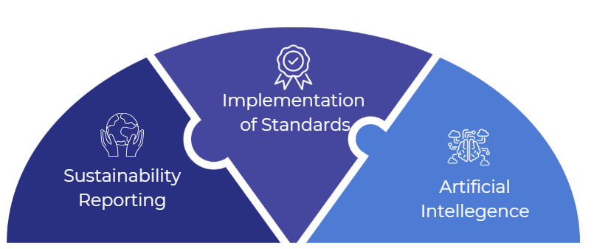
PSC consolidated workplan

Slide 5

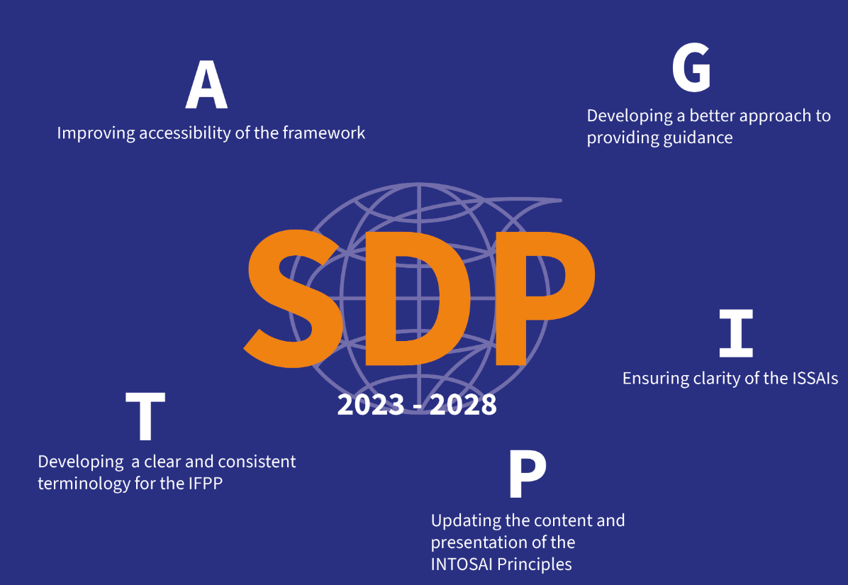
07

Slide 6
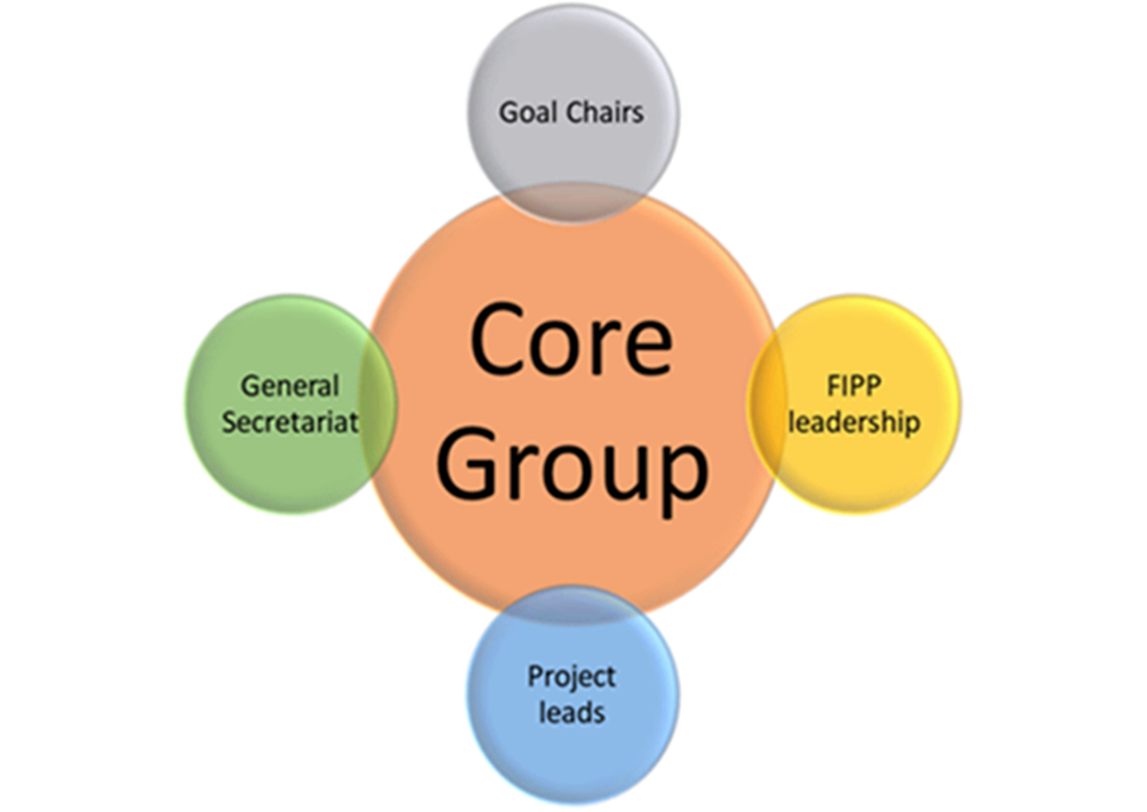
Implementation of the SDP
Five project teams started their work with the aim of - examining aspects of the framework - making adjustments and improvements for the benefit of all users.
Teams are supported by the PSC, the Core Group, the FIPP and its liaison officers, PSC responsible for leading the core group.
PSC Steering Committee retains overall responsibility for implementing the SDP.

Slide 7
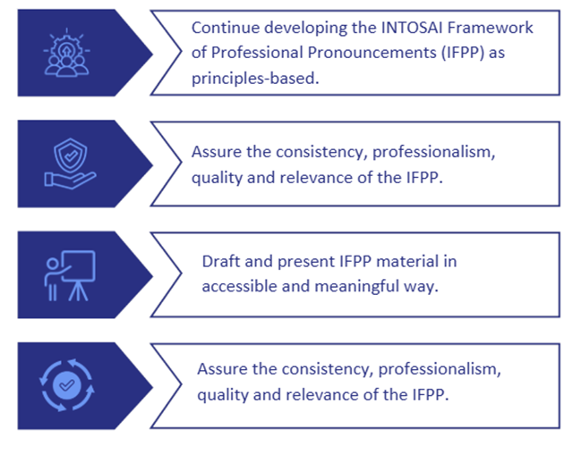
PSC’S STRATEGIC DEVELOPMENT PLAN
2023-2028
4 strategic objectives

Slide 8
1.1 Continue developing the INTOSAI Framework of professional pronouncements (IFPP) as principle-based and ensure a dynamic and flexible provision of guidance and other supporting materials
Key highlights
Analyse the applicability of the ISA for LCE – (less complex entities) and the updates of
ISAs (in particular 240, 330, 500, 501, 505, 520, 530, 570) for our IFPP and propose
updates/guidance via GUID 2900 if needed,
Clarify the status of INTOSAI GOVs within the IFPP and determine appropriate actions to
preserve relevant guidance, whilst ensuring overall coherence and clarity,
Assess the applicability of current IFPP standards and guidance to foresight auditing and
provide recommendations for integrating forward-looking audit approaches.
ISSAI 130 – is this the answer to our AI worries?

Slide 9
1.2 Assure the consistency, professionalism, quality and relevance of the IFPP, and regularly update the IFPP technical content in response to developments in the audit profession and user feedback
Key highlights
Strengthen collaboration between the PSC and the IDI to promote the PESA as a professional
qualification to underpin the professionalism of SAI auditors,
Strengthen the effectiveness, continuity, and knowledge management of FIPP by improving
resourcing, staffing, and succession planning,
Assess the feasibility of a structured training programme and curriculum that equips INTOSAI
standard-setters with the skills, knowledge and methodologies needed to develop high-quality,
credible and globally relevant professional pronouncements.

Slide 10
1.3 Draft and present IFPP material clearly, while leveraging technology to ensure it is accessible in a way that is meaningful to users
Key highlights
Deliver a more accessible, digital and user-friendly IFPP allowing
easier application of the ISSAIs,
Enhance the effectiveness of the PSC’s social media and
communications outreach.

Slide 11
1.4 Advocate for, support and monitor the implementation of the IFPP by SAIs, in order to gain feedback on its relevance and use, and to identify opportunities for improvement
Key highlights
Enhance coordination with INTOSAI Regions,
Broaden the membership of the PSC Steering Committee to assign members
Particular responsibility of regional contacts,
Work closely with the Supervisory Committee on Emerging Issues (SCEI,
Maximise the value from consultative and advisory partners,
Enhance the effectiveness of the INTOSAI Standards Liaison Officers network.

Slide 12
Making operational our MoUs with IFAC and IDI
Core “To-Do s” for all parties
Collaboration on Standards and Public Financial Management,
Knowledge Sharing and Mutual Learning,
Joint Events, Dialogue and Outreach,
Capacity Building and Donor Engagement,
Practical Cooperation Mechanisms,
Common Messaging and Advocacy.
Notes:
Core To-Dos for All Parties
1. Collaboration on Standards and Public Financial Management
• Work together on issues of mutual interest related to public-sector auditing, accountancy, and accountability.
• Support adoption and implementation of:
o INTOSAI standards (ISSAIs),
o IFAC standards (including IPSAS, auditing and ethics standards, as relevant to the public sector).
• Encourage partnerships between INTOSAI SAIs and IFAC member organisations to strengthen public-sector audit and accountancy capacity.
________________________________________
2. Knowledge Sharing and Mutual Learning
• Exchange knowledge, experience, and best practices relevant to public-sector auditing and accountancy.
• Increase awareness of each other’s activities by:
o Sharing documents and information,
o Attending relevant meetings and working groups,
o Participating in task forces or advisory groups where agreed.
________________________________________
3. Joint Events, Dialogue and Outreach
• Organise or contribute to joint events, forums, and dialogues.
• Use these platforms to:
o Advance shared objectives,
o Engage stakeholders,
o Promote high-quality public-sector auditing and accountancy.
________________________________________
4. Capacity Building and Donor Engagement
• Coordinate engagement with donors and development partners.
• Leverage synergies in capacity-building projects, especially those supporting SAIs in developing countries.
• Align INTOSAI/IDI capacity development efforts with relevant IFAC initiatives where beneficial.
________________________________________
5. Practical Cooperation Mechanisms
• Be available for consultation on matters of common interest.
• Facilitate access (where appropriate) to:
o Audit reports,
o IT tools,
o Training and guidance materials.
• Establish meetings or task forces between the parties or with IFAC bodies, as needed.
________________________________________
6. Common Messaging and Advocacy
• Coordinate and promote common messages on shared issues.
• Where relevant, align responses to public consultations or policy discussions affecting public-sector auditing and accountancy.
• Promote relevant initiatives and publications from all parties.
________________________________________

Slide 13

A new addition to the PSC family
Working Group on due process
Approved by the Governing Board in March 2026
Terms of reference for WG and for PSC for next PSC-SC
Table of priorities

Slide 14

PSC-Steering Committee
Financial Audit & Accounting Subcommittee
(NAO / SAI Sweden)
Performance Audit Subcommittee
(SAI Ireland)
Internal Control Standards Subcommittee
(SAI Poland)
Compliance Audit Subcommittee
(SAI India)
Working Group on due process
(PSC Secretariat)
New structure

Slide 15

INTOSAI ORGANISATIONAL CHART
INCOSAI CONGRESS
INTOSAI Development Initiative
Supervisory Committee on Emerging Issues
GOVERNING BOARD
International Journal of Government Auditing
Regional Organisations
Secretary General
Austria
INTOSAI Strategic Goals
PROFESSIONAL STANDARDS
CAPACITY
DEVELOPMENT
KNOWLEDGE
SHARING
MAXIMISE VALUE
OF INTOSAI
Professional
Standards Committee
PSC
Capacity building
Committee
CBC
Knowledge sharing
Committee
KSC
Policy, finance and administration committee PFAC
ECA & Brazil
(SA & Sweden)
India and Czechia
Saudi Arabia & USA
FORUM FOR INTOSAI PROFESSIONAL PRONOUNCEMENTS (FIPP)

Slide 16
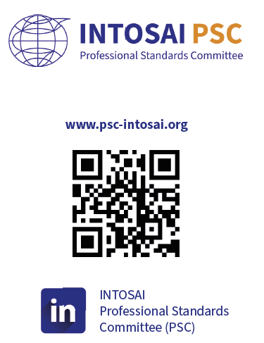
THANK YOU

