Slide 1

CITIZEN-CENTERED AUDIT
Because this school is yours

Slide 2




SAI Brazil
Guidelines 2025-2026
Promoting citizen participation in oversight
Strengthening institutional dialogue
Focusing on results that improve citizens’ lives
Modernising the institution and expanding the use of technology

Slide 3

Preliminary survey
Pilot project for structured listening within oversight activities.
Based on the real experiences of those directly involved in secondary education.
Partnership with institutions responsible for the governance of the public policy.
Focus: identifying systemic failures in the implementation of the public policy.
Territorial scope: the municipality is used as the unit of analysis to understand how the public policy actually reaches citizens.

Slide 4



WHY DID SAI-BRAZIL
CONDUCT THIS SURVEY?
to identify the main challenges and opportunities for improvement
from the perspective of the entire school community
to inform and guide future oversight actions

Slide 5
Survey dimensions
Sense of belonging and school community
Quality of teaching and curriculum
Student motivation and engagement
Teacher–student relationship and teacher recognition
Infrastructure and support

Slide 6
Administration-centered tests
Citizen-centered tests
Analyse teacher qualification records and hiring procedures.
Verify compliance with curriculum guidelines.
Collect students’ feedback on teaching practices and learning support.
Identify barriers to learning reported by students.

Slide 7
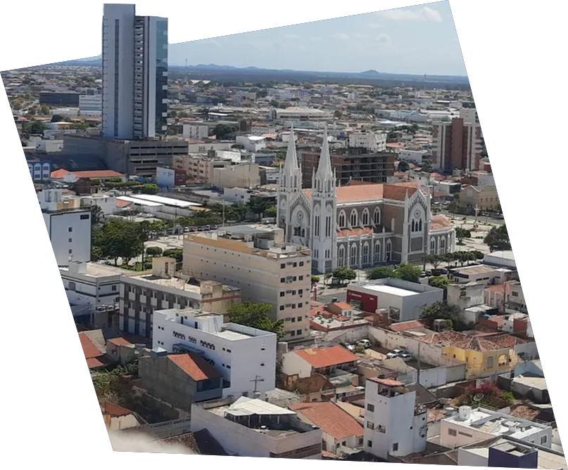
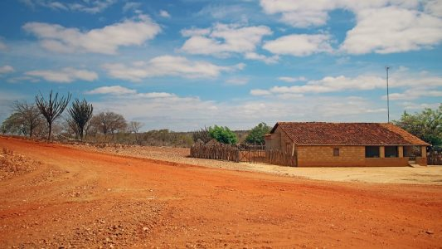
THE SELECTED MUNICIPALITY: PETROLINA
More than 200,000 inhabitants
50% of schools in rural areas
Human Development Index (HDI) close to the national average
GDP per capita below the national average

Slide 8

HOW IT WAS CONDUCTED
In-person listening sessions combined with remote consultation with the entire school Community
Analysis of convergences and divergences among institutional listening, open-source research (OSINT), technical reports, academic literature, and statements from public managers
Identification of “pain points” and “frictions” in the citizen’s journey through secondary education
Development of a diagnostic approach that can be replicated in other national contexts

Slide 9

HOW AI WAS USED
Adaptive Question Generation
Processing of 50 hours of audio
Incorporation of AI insights
Assistance in drafting the report

Slide 10
Adaptive Question Generation
Considering your daily routine, what simple action could the school implement this semester so that students with children could attend classes without missing them?

Slide 11




participants in in-person listening sessions
school managers
responses to the online questionnaire

Slide 12


Some Risks Identified
Sexual harassment and threats
Inadequate infrastructure for full-time schooling
Overburdened teachers

Slide 13

It is not feasible to work with 45 students in the context of our school, where classrooms can accommodate at most 30 students and do not have air conditioning.

Slide 14
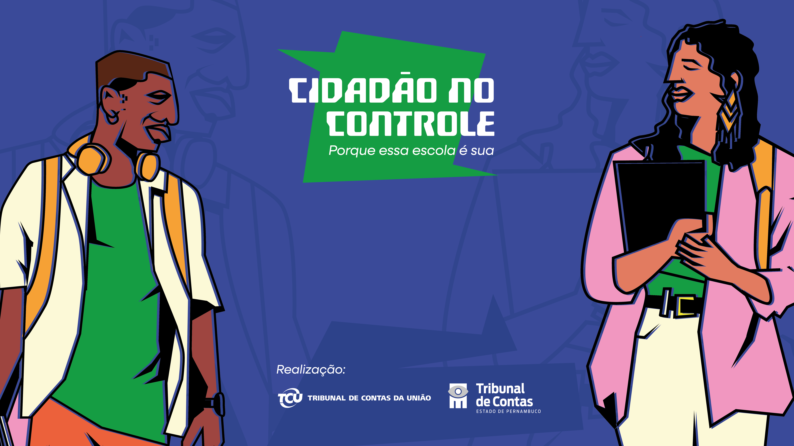
Thank you!
Marcelo Eira
seinc@tcu.gov.br
www.tcu.gov.br/cidadaonocontrole

