Slide 1


Dr. Vargha Bálint Tamás Lead Analyst, Special Analyses Department
Will AI replace humans?
A critique of forecasting labour market processes associated with AI and automation
25 03 2026
Notes:
Contrary to what everybody expects me to do. So I am not going to talk about that terrifying dystopian future when robots take over the world, and the terminator steals your parking space. Much rather have a sober look whether the forecasts on the takeover of AI are trustworthy.

Slide 2
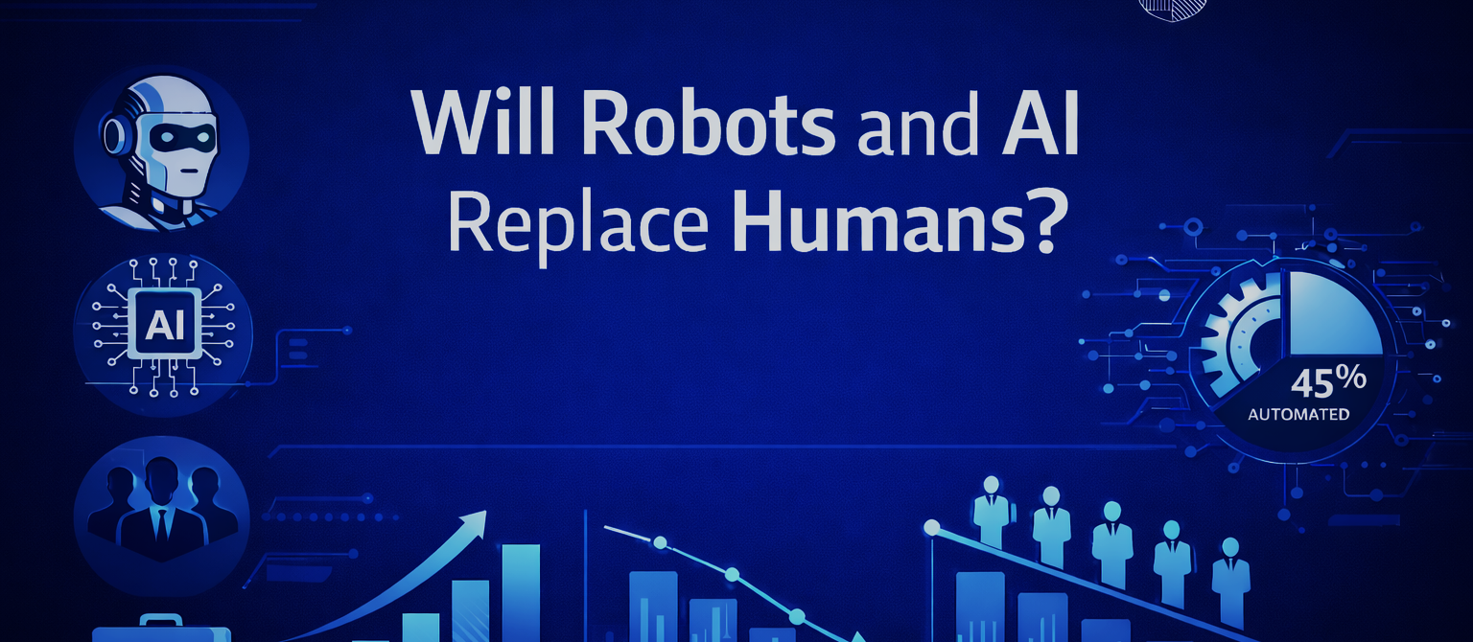
Why are we addressing this topic?
The Fiscal Council supports the Parliament by assessing the soundness of the central budget.
It also requires forecasting key macroeconomic trends, including labour market developments.
The State Audit Office of Hungary also contributes through its analysis of AI’s labour market impacts.
Notes:
Why does the SAO of Hungary address this topic at all? Advances in automation and AI technology may have a dramatic impact on the structure of the labour markets worldwide.
The following questions must be taken into consideration:
-Which occupations will be automated?
-How quickly and to what extent will this change take place?
-And, fundamentally, what impact will this have on the Hungarian economy?
The SAI of Hungary regularly provides analysis on the Central Budget of Hungary to the Fiscal Council. It is a body that supports the Parliament by providing an opinion on the soundness of the Budget. In order to assess the reliability of the Budget, it is also necessary to deal with certain macroeconomic developments, including labour market processes.
That is why we have decided to investigate to what extent one may trust these forecasts.

Slide 3
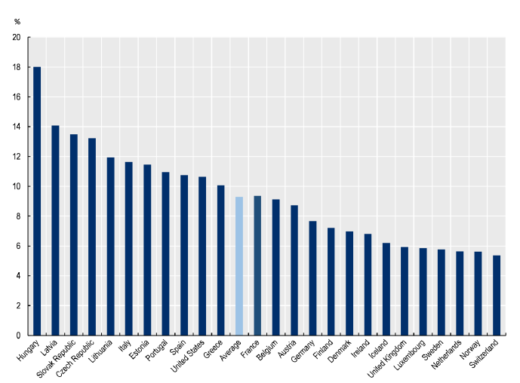
According to forecasts Hungarian jobs are particularly exposed
Share of employment in occupations at high risk of automation, by country
(Source: OECD, 2022)
Notes:
Many organisations have carried out studies trying to figure out how new tech will change the job markets.
According to forecasts, jobs in Hungary are particularly vulnerable to the expansion of artificial intelligence and robotics. We assume that this is due to the structural characteristics of Hungary. It is a small, export-oriented economy, high share of employment in manufacturing.
On the other hand the labour market forecasts show great variance, as you see. The range is 23 to 60 % of the affected proportion of labour force. This suggests that they either attempt to quantify entirely different pehnomena or the reliablity of the forecasts is questionable the best.
This in an on of itself underlines that it is worth to investigate how these data is produced, what data and what methods are being used, and what may cause the divergence in the results.

Slide 4
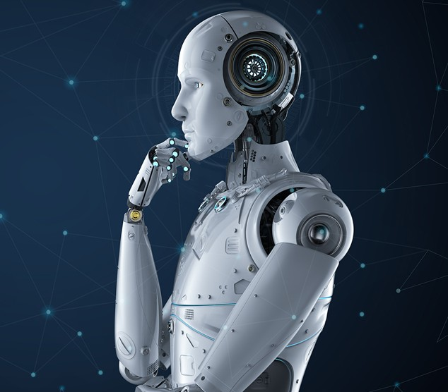
Research questions
Methods
Criteria
Reliability
Defining key terms
Notes:
Therefore the aim of our analysis was to dig deep into the actual methods, criteria and calculations used by forecasting think tanks. These were Pwc, Mckinsey European Comission, and OECD.
Furthermore, we also assessed the reliability of these forecasts in terms of the most fundamental scientific requirements.
In addition we also attempted to define the precise definitions of the most frequently used terms. So what does artificial intelligence, automation, robotics mean.

Slide 5




What criteria did we use for the evaluation?
Examination of economic and social conditions: To what extent does the forecast take into account the actual economic mechanisms of the labour market, the cost constraints, and path dependencies?
Methodological limitations, data quality: Is the methodology based on coherent, relevant and timely data?
Transparency: How transparent and accessible are the methodological steps, the models used, and the data sources, i.e. can the way the results were obtained be traced back?
Use of terminology: Does the forecast define key terms accurately and consistently?
Notes:
How did we establish scientific quality?
In our comparative analysis, the forecasts are assessed within a unified evaluation framework.
First of all we analysed the extent to which the forecasts take into account the broader economic and social context. This involves assessing whether they reflect the actual economic mechanisms of the labour market, like the cost constraints.
We examined whether the methodology is coherent and whether it is based on relevant, reliable, and up-to-date data.
We also evaluated transparency. This includes the extent to which the methodological steps, applied models, and data sources are accessible.
We examined the use of terminolgy, we assessed whether each forecast defines its key terms precisely and consistently.

Slide 6
Why can’t we blindly trust the forecasts?
Notes:
So lets wee why these forecasts may give a misleading picture.

Slide 7




Which forecasts did we evaluate?
Szervezet | Elemzés | Scope | Time frame | Datas | Method
 | OECD. (2023). OECD Employment Outlook 2023: Artificial Intelligence and the Labour Market, OECD Publishing, Paris | International | NA | O*NET EU-LFS 35 skills and 52 abilities related to 1000 occupations | Expert assessment (20 expert) skills and abilities related to automation on a 7-point scale
 | OECD. (2024). Job Creation and Local Economic Development 2024: The Geography of Generative AI, OECD Publishing, Paris | International | 2024 | O*NET 19 265 tasks and 2087 activities | Expert assessment on how much faster various work activities (1016) can be performed using generative AI technologies (3-point scale)
 | PwC Magyarország. (2019). How will AI impact the Hungarian labour market? | Domestic | 2030 | From the O*NET, PIAAC, EU-LFS databases assessed 702 occupations based on 9 key competencies | Expert assessment: "Can the given occupation be fully automated in the near future (within 10-20 years) based on the development of computer technologies?"
 | McKinsey & Company (2018): Átalakuló munkahelyek: az automatizálás hatása Magyarországon. Budapest: McKinsey & Company. | Domestic | 2030 | MGI, O*NET, PIAAC, EU-LFS examined 420 occupations in Hungary and assessed the automatability of jobs by analysing 2,000 subtasks and 18 technological capabilities | Assessment of the necessary skills and the dimensions influencing automatio (technical feasibility, cost-effectiveness, Labour market and societal acceptance, Regulatory environment, Societal impacts, Technology availability and prevalence)
 | Lordan, G. (2018): Robots at Work: A Report on Automatable and Non-Automatable Employment Shares in Europe. Luxembourg: Publications Office of the European Union. | international | NA | ISCO (occupations), DOT (skills and abilities), Google Patents (patents), EU-LFS ( occupational composition) | Evaluation of 323 occupations based on the DOT database in terms of routine intensity (RTI), supplemented by the Google Patents database
Notes:
The six studies we assessed aim to quantify the impact of automation using a wide range of methods.
PIAAC,O*NET and EU-LFS are the primary data sources. The impact of AI and automation itself is quantified on several levels: the proportion of skills that can be automated, the percentage of working hours, and the number of jobs affected.
However what can be established is that the main data source for all forecasts is nothing but a very granular and detailed desciption of an individual task. This desciption is than taken by so called group of experts who will assess to what extent the described task can be automated or replaced by AI according to the current standard of technology.

Slide 8
To what extent are economic and social factors taken into account?
Previous industrial revolutions
Path dependency, social resistance,regulations
Cost relationship between labour and technology
Not just substitution effect!
Only the McKinsey study incorporated factors limiting the spread of innovation into its model.
Notes:
While the forecasts breakdown work activities into very detailed components based on highly detailed databases, their focus is primarily on the extent to which skills and abilities can be automated. And this clearly points to one of the biggest limitations of these studies: They do not take into account economic and social limits of the spread of technology.
First of all these forecasts presuppose a more or less universal spread of technology. However previous industrial revolutions have shown that the spread of technological innovations is not universal, and their pace is not even either. Earlier technological solutions and the latest innovations always coexist.
Path dependency: that is the relative efficiency of already existing modes of production, industry standards, supply chains. Forecasts do not take into account the inertia of an already existing technology in an industry.
The factor of costs is just as important. In a low wage economy the return on investments required to introduce new technologies may take a longer time. Unfurtunatly this aspect is rarely problematised by the forecasts.
Furthermore, past industrial revolutions do also teach us that technological innovations do not always eliminate jobs, but rather transform them: some tasks disappear, while new, more complex jobs appear, and it is also possible that at the end of the day this will lead to higher employment levels.
Only the McKinsey study attempted to incorporate factors limiting the spread of innovation into its model and problematised the cost relationship between labour and technology as well as the inhibiting effects caused by path dependency in the economic and social environment.

Slide 9
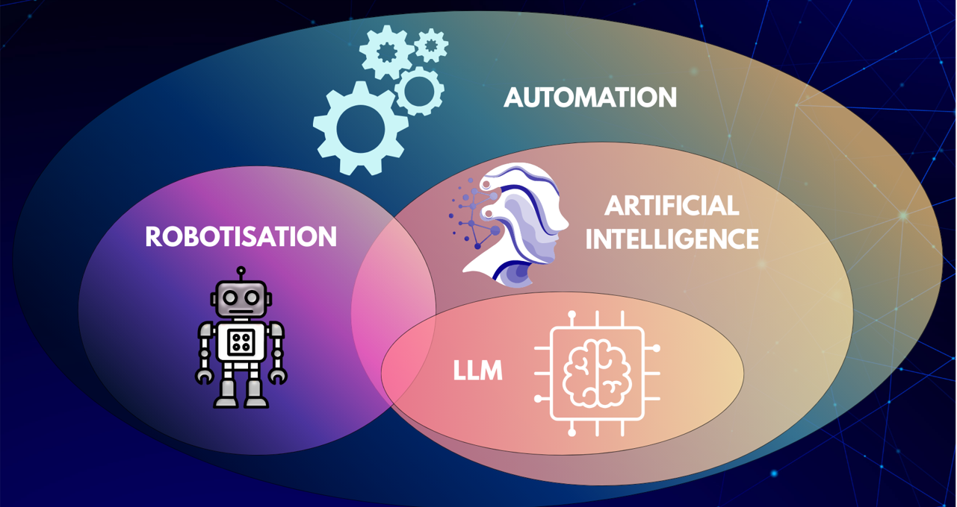
Forecasts do not use the terms consistently!
Notes:
So what about the precise usage of terminology?
In the broadest sense, automation means that a process is performed by machines or software according to predefined rules without human intervention. Robotisation is a special case of automation, where physical or software robots perform human work. The concept of artificial intelligence refers to computer systems that are capable of learning, reasoning, making decisions and adapting to changes in their environment. Although it can support automation processes, not all automation involves the use of AI.
In general we have established that the studies reviewed generally do not define and delineate clearly the above concepts. An indirect and somewhat tautological definition of robotisation can be found in only two cases.
What is even more concerning that the results are interpreted in a way that does not make it clear for the reader exactly which technology has been examined. This has serious consequences because AI has a potential in high added value jobs, whereas robotisation much rather has an effect in brick and mortar tasks.

Slide 10
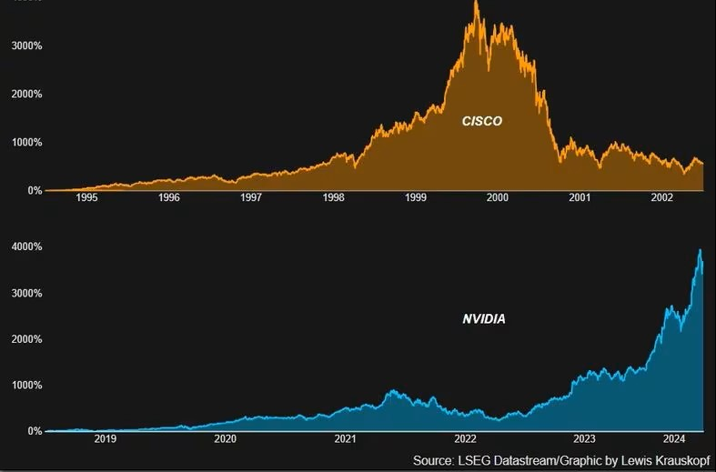
The effects of self-fulfilling expectations
Forecasts shape the perceptions of decision-makers and investors – a positive feedback loop
Not a cause, but a justification (for example, in the case of layoffs)
Even if it's a bubble, in the long run it might still validate the expectations!
Some forecasts come from industry players who may have an interest in overestimating the labour market effects
Notes:
What should also be bourne in mind is that forecasts are never fully descriptive, they inevitaby influence the subject matter as well.
Thus, the impact on the labour market may be further exacerbated by the fact that forecasts significantly influence the expectations of decision-makers, investors. They also provide excellent justification to carry out otherwise planned staff reductions.
Besides it should also be noted that some of the forecasts come from industry players who may have an interest in overestimating the labour market effects of AI and robotisation.
Furthermore, it is important to note that market expectations for new technologies are always subject to hype similar to that seen during the dot-com bubble. At the same time, as was the case with market expectations at the dawn of the internet , even if what we see now proves to be a bubble in the short term, it does not rule out the possibility that the technology will bring about very significant changes in the economy in the long term.

Slide 11

Limitations of data quality
The actual distribution of skills in a real labour market differs from that of the dataset used
They draw conclusions for a time horizon of over 5 years based on data older than 5 years.
Notes:
We have also ascertained that forecasts build on a kind of data that leads to greater uncertainty when assessing actual labour markets.
First of all PIAAC an ONET databases do not reflect the global differences of actual skills required to do a job. The actual work process and the human labour requirement thereof shows significant variance in the world economy.
Secondly they are based on data collected two, three or even five years ago. On average, these analyses examine the technological and social situation 5-10 years prior to their publication. There is a 10-20 year gap between the reference period of the estimates and the data used for the predictions. Given that this is an explosively fast-growing sector, the reliability of these forecasts is difficult to imagine, if only because of how quickly they become outdated.
Therefore instead of predicting the future an attempt should have been made to examine the extent to which the forecasts made have come true in light of the time.

Slide 12
Do we see that AI is taking our jobs?
(Based on statistics so far)
Employment rate trends in the 15-74 age group (%)
Changes in the number of people employed in the manufacturing industry
Notes:
So instead of relying on future telling of the forecast we have taken a look at a few of the most characteristic labour market indicators.
The employment rate grew steadily in the 2020s, following the decline caused by the pandemic. Employment rate for the 15-74 age group in 2024 was 2.8 percentage points higher than four years before.
We have to bear in mind that this is a ratio, therefore affected by the number of people of working age, and the Hungarian population has been ageing for years, so this group of people is getting smaller positively affecting employment rates.
Therefore we have taken a look at this in absolute terms as well. We see that in the manufacturing industry there has been an increase here too, as shown in the figure.

Slide 13
Do we see that AI is taking our jobs?
(Based on the statistics so far)
Decline in the number of job vacancies between 2018 and 2023
Development of job vacancies between 2018 and 2023
Notes:
Taking a look at the supply side: the number of job vacancies fell significantly between 2018 and 2020, then began to rise rapidly, peaking in 2022. This trend points to a worsening labour shortage, which moderated in 2023 but remained at a fairly high level. The number of job vacancies in the manufacturing industry fluctuates significantly. In contrast, the number of vacancies in the information and communication sector remained low and stable throughout.
To sum up labour market data from the past six years do not confirm that automation or AI so far had a significant impact on Hungarian jobs.
Although when comparing forecasts and actual data, it must always be borne in mind that the latter are influenced by a number of factors other than automation.

Slide 14
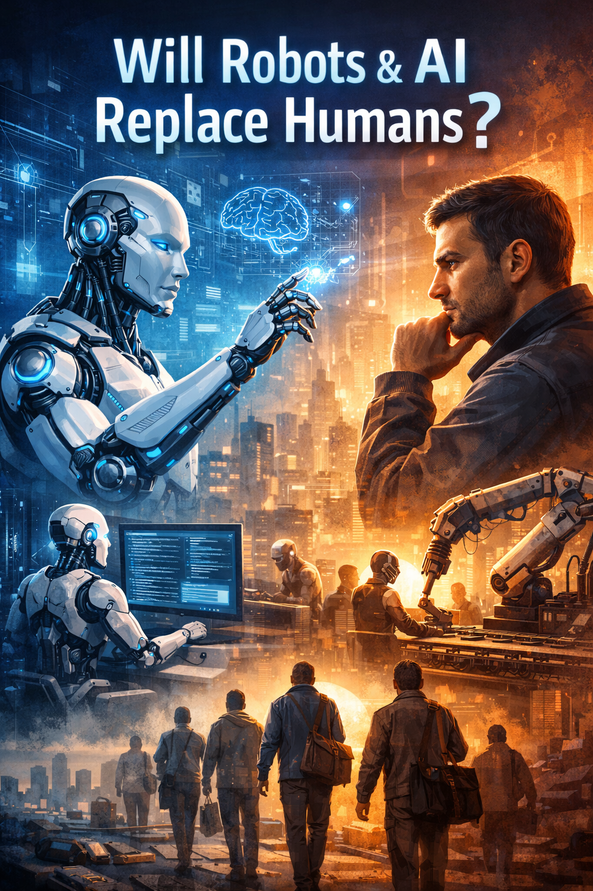
To sum up…
There is a strong tendency to overestimate automation and AI labour market effects.
Nonetheless it does not mean it wont transform economies in the long run.
More granular national labour market specific, and company level data is required to provide reliable forecasts.
Notes:
Overall there is a high chance for these forecasts to overestimate job market effects of new technologies.
However we should not jump to early conclusions on a market bubble. It is certainly something more fundamental going on.
And there is still a need for better data. Also qualitative research methods, to see upclose on the level of companies the real drivers behind automation.

Slide 15
Dr. Vargha Bálint Tamás Lead Analyst Special Analyses Department
Thank you for your kind attention!
25 03 2026

