Slide 1


Processing 3,495 documents
(164,672 pages) in one night
Kristóf KOVÁCS, IT architect
State Audit Office of Hungary
INTOSAI PAS Annual Meeting | Budapest, 2026 |

Slide 2
Processing 35 years of SAI Hungary’s reports with AI
1990 – 2025 (and continuing!)

Slide 3
Why?
In our work at the State Audit Office of Hungary (SAO) we are constantly handed huge stacks of documents, PDFs, scanned materials and other unstructured documents.
Going through them by hand is always slow, boring, and prone to mistakes.
AI seemed like an idea fitting for our times against this.
And 35 years of SAO reports seemed like a very diverse corpus to start an AI experiment on. ☺

Slide 4
What did we work from? 3495 PDF files
Mostly scanned
Some of them are with typewriter
Photocopied crookedly, possibly several times

Slide 5
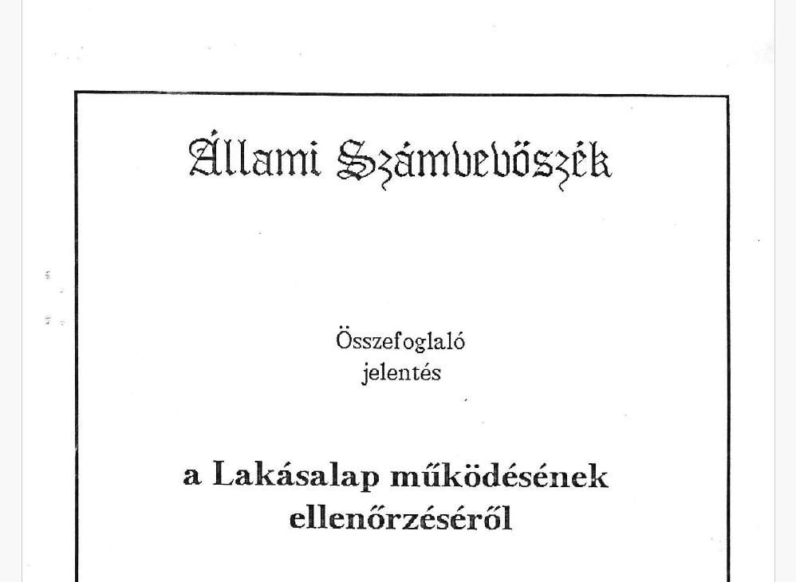

Slide 6
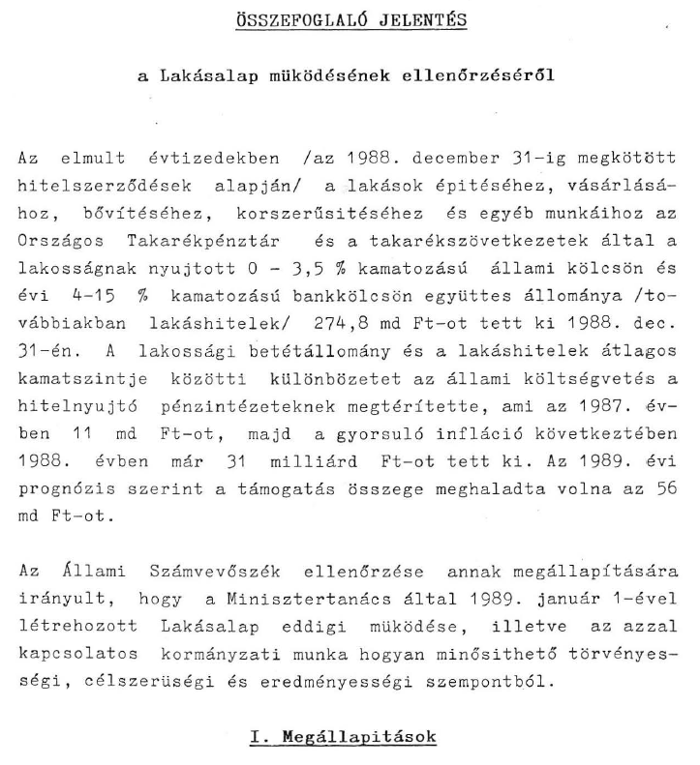
👍

Slide 7
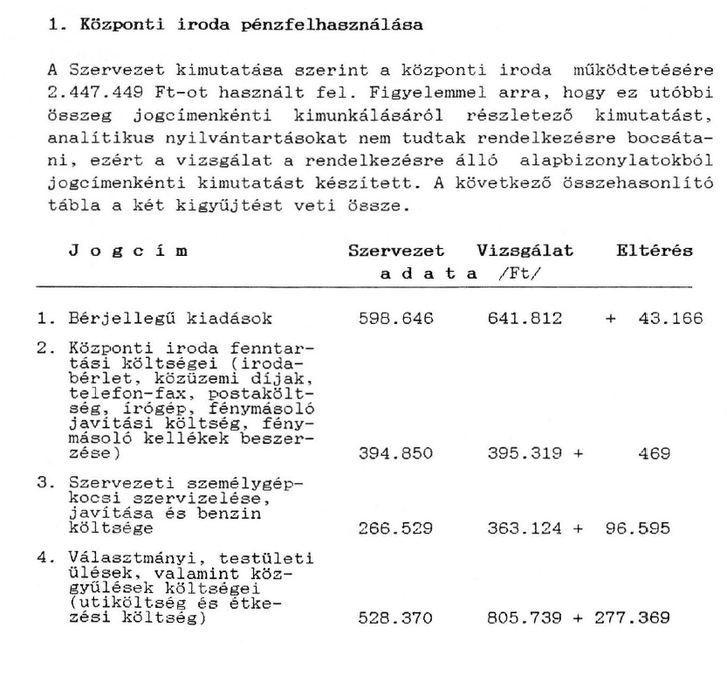

Slide 8
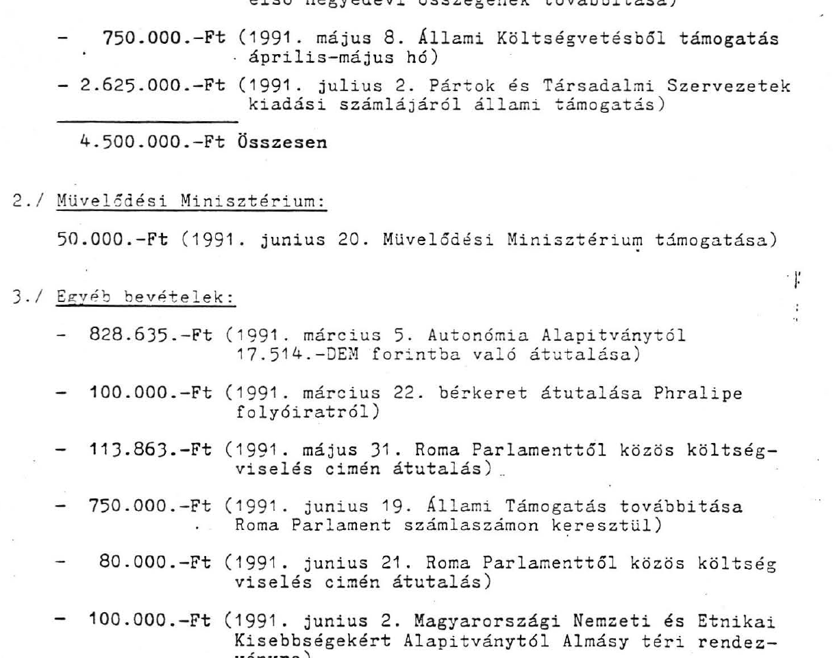



Slide 9
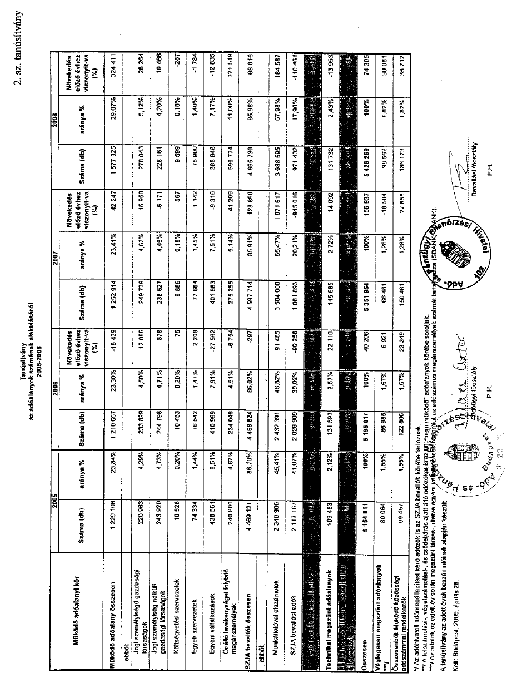

Slide 10



Slide 11
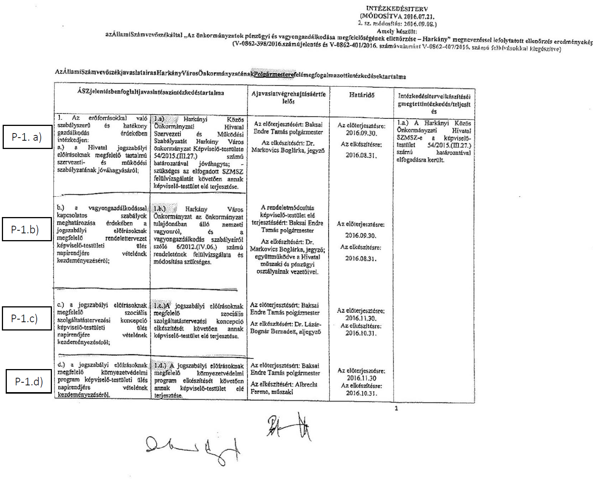

Slide 13
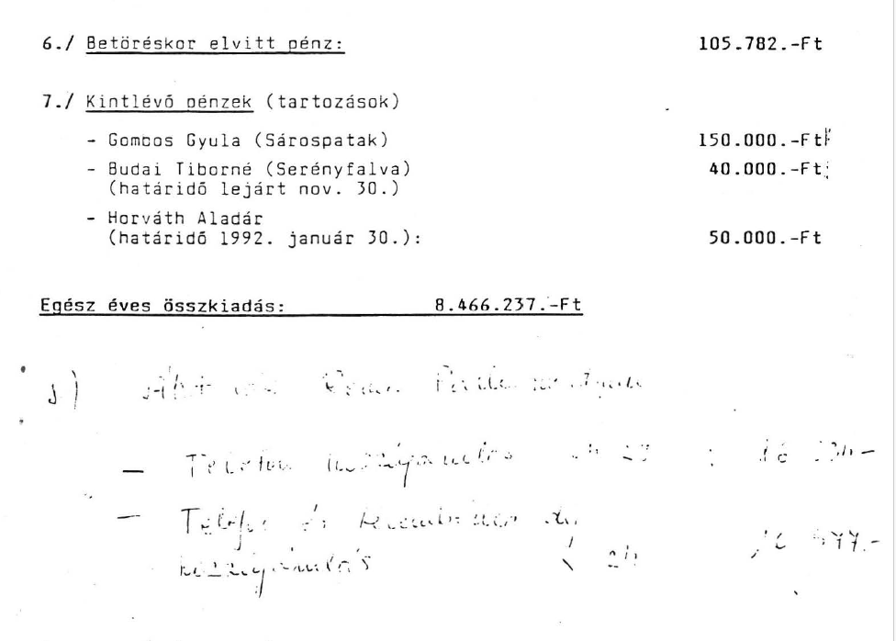
😅

Slide 14

We have procured our own AI-capable hardware (2x Nvidia H100 GPUs)

Slide 15


🌞 Chat at day
ai.asz.hu, „personal”
🌜 API at night
software-controlled, „industrial”

Slide 16
But 3495 reports (164,672 pages) worth of text won’t fit in the AI „context”.
Imagine a teacher who has to grade an entire class.
The teacher doesn’t dump all the exams on the floor, glance at them, and announce “the average grade is 3.8”.
Instead, the teacher reads each paper, marks it, and then calculates the class average from those individual scores.

Slide 17
We used the same idea with AI:
Take a single document (a PDF or scanned file).
Ask the AI clear, fixed question(s): e.g., “What are the main findings in this report? What financial figures are mentioned in this report?”
Record the AI’s answers in a structured format.
Move on to the next report and repeat the previous steps.
Summarize the AI’s answers in a spreadsheet.

Slide 18

One by one.

Slide 19
How does it look like in real life?

Slide 20
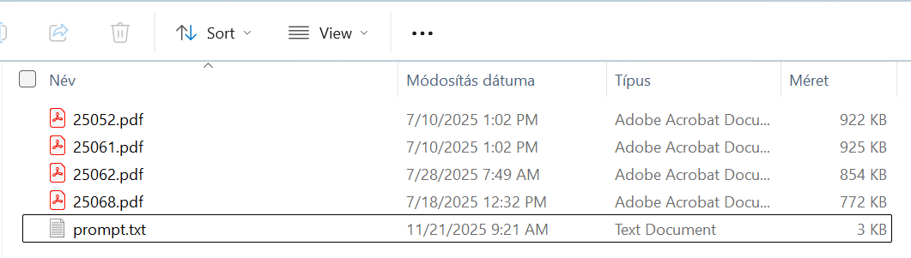
1. Put documents and prompt.txt in a folder.

Slide 21
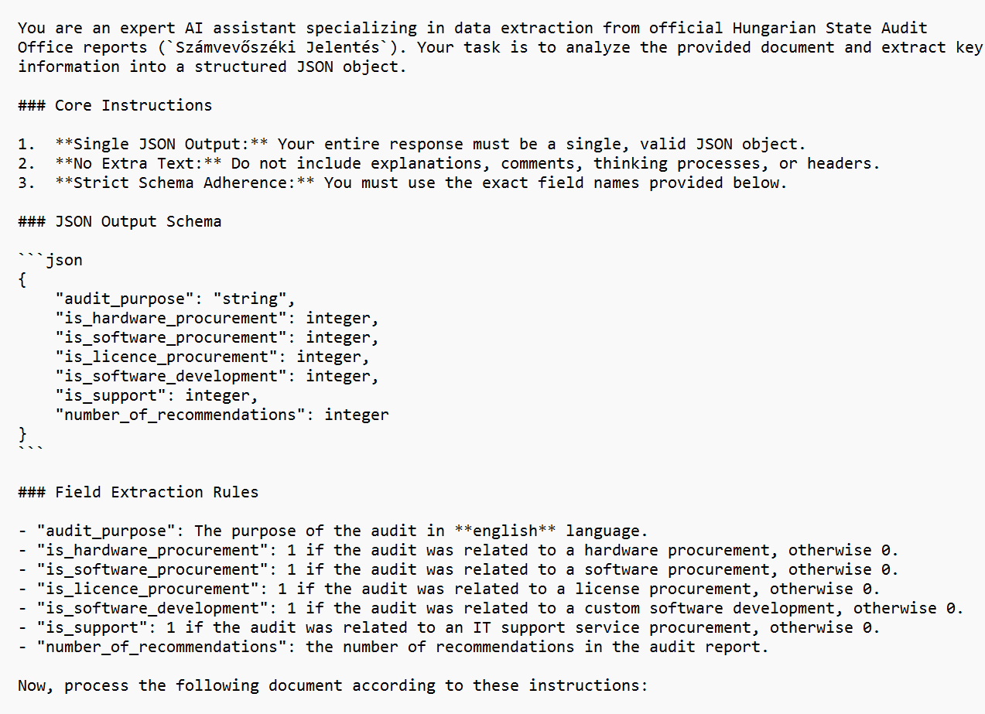
prompt.txt
AI’s role
Output format
The expected structure of his answer
More nuanced description of the task at hand (can be very long)

Slide 22
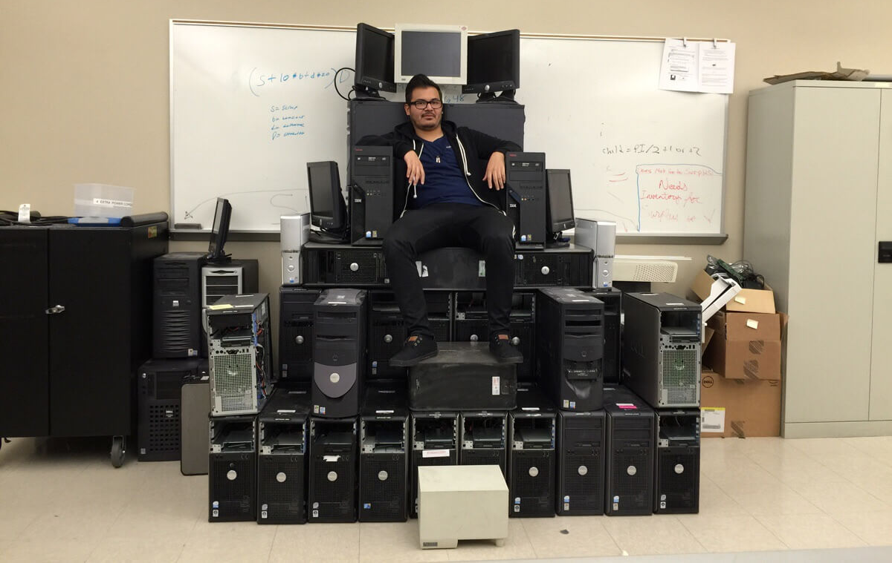
2. Ask IT to initiate AI processing on the folder

Slide 23
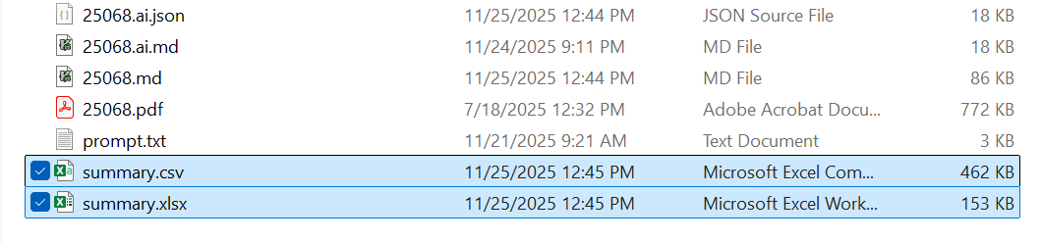
3. Your prompt runs for every document, and finally, a summary spreadsheet is generated.

Slide 24
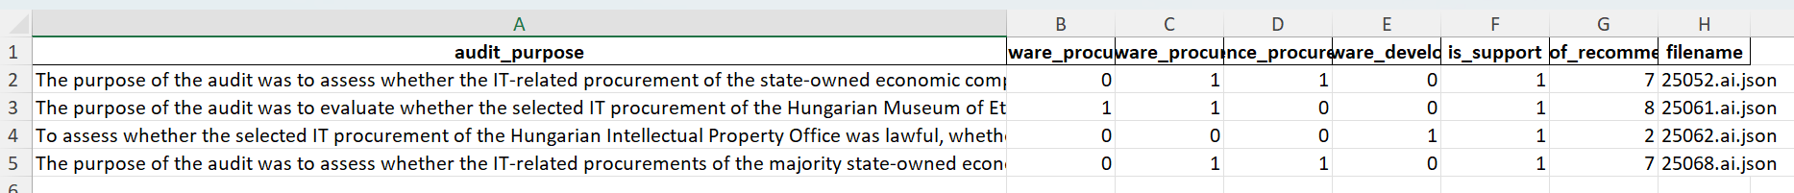
summary.xlsx looks like this:

Slide 25
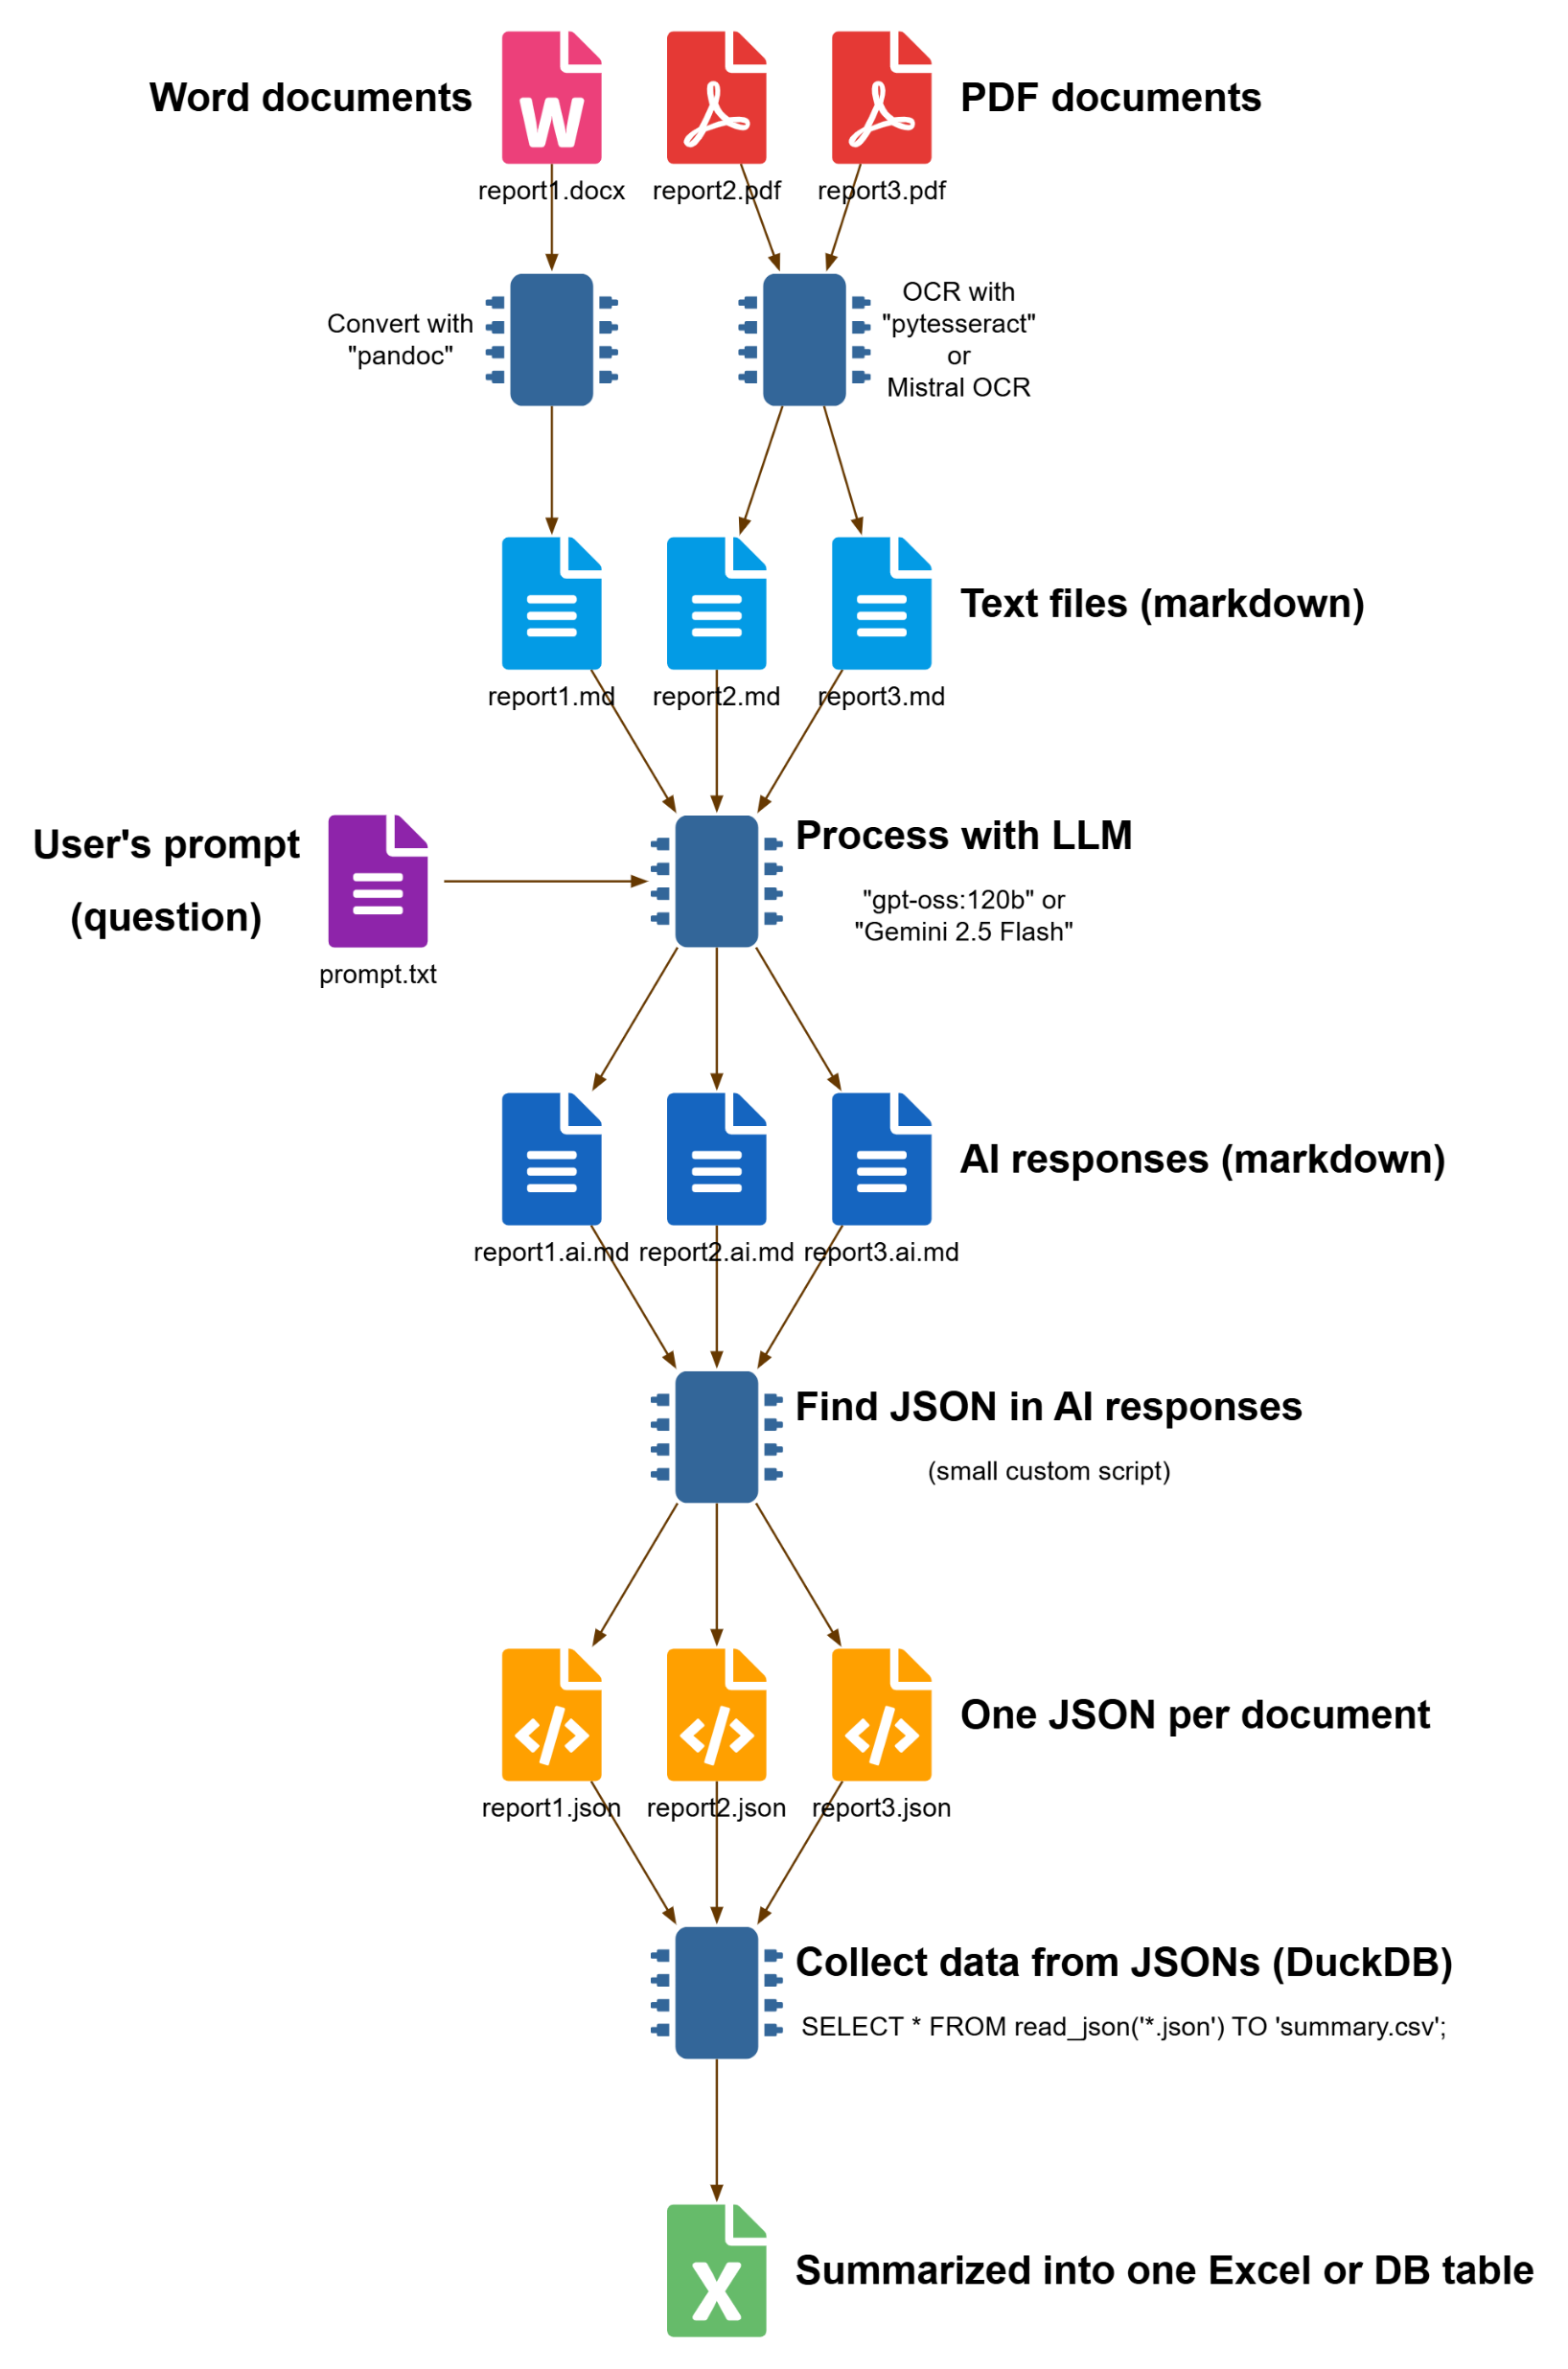
What happens in the background
(Trust the process.)

Slide 26
What happens in the background
(Trust the process.)

Slide 27
3495 documents in a single night

Slide 28
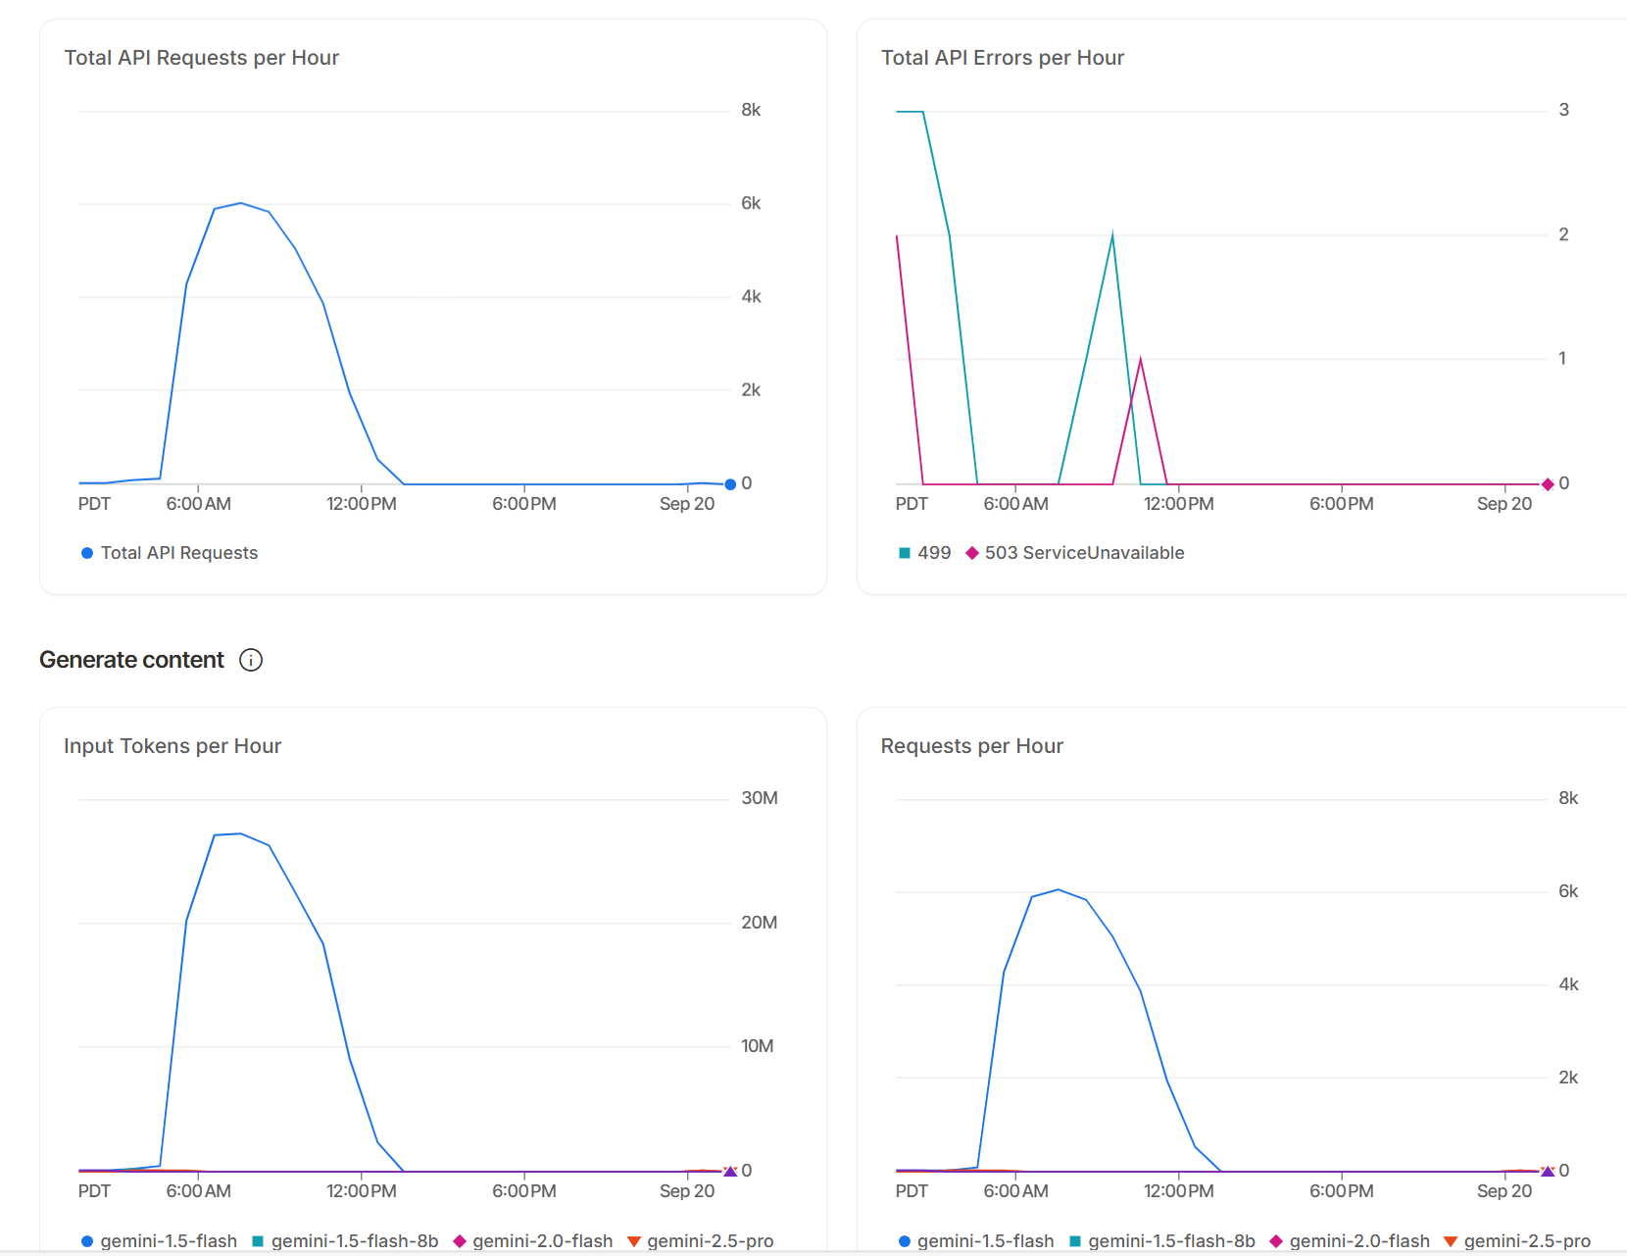

Slide 29
For me, the most exciting outcome is the document mass-processing AI tool, that we can now use for any pile of documents.

Slide 30
But my colleagues have created more visually pleasing outcomes too...

Slide 31
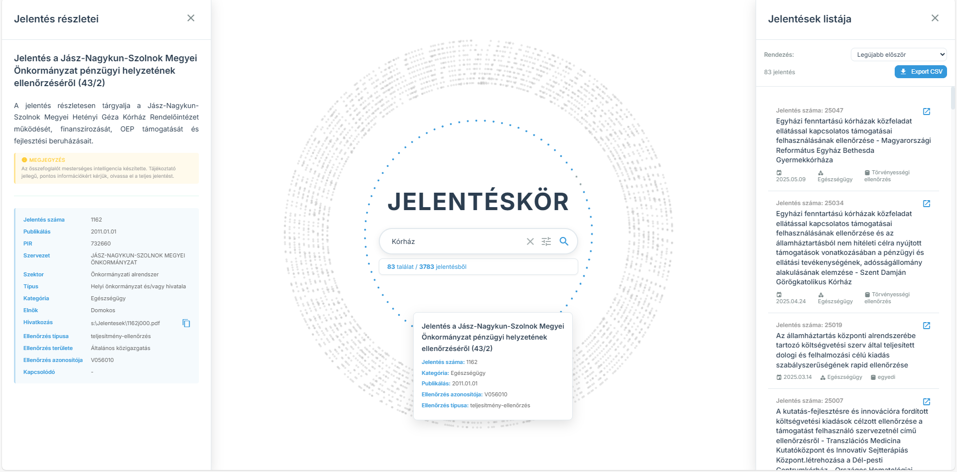

Slide 32
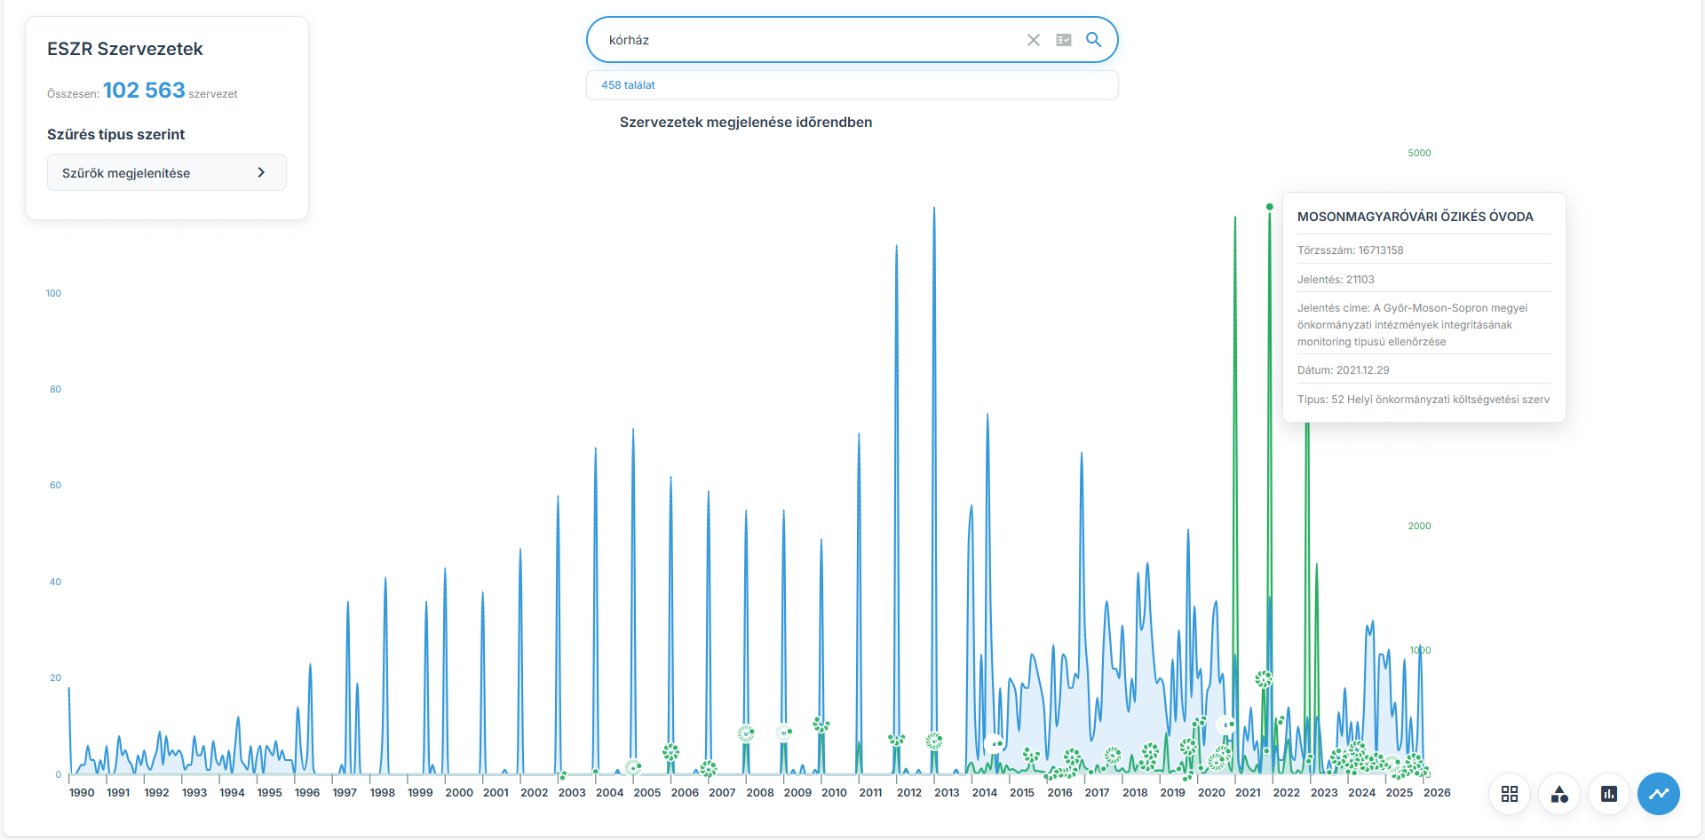

Slide 33
Thank you!
Questions?
INTOSAI PAS Annual Meeting | Budapest, 2026 |

Slide 34
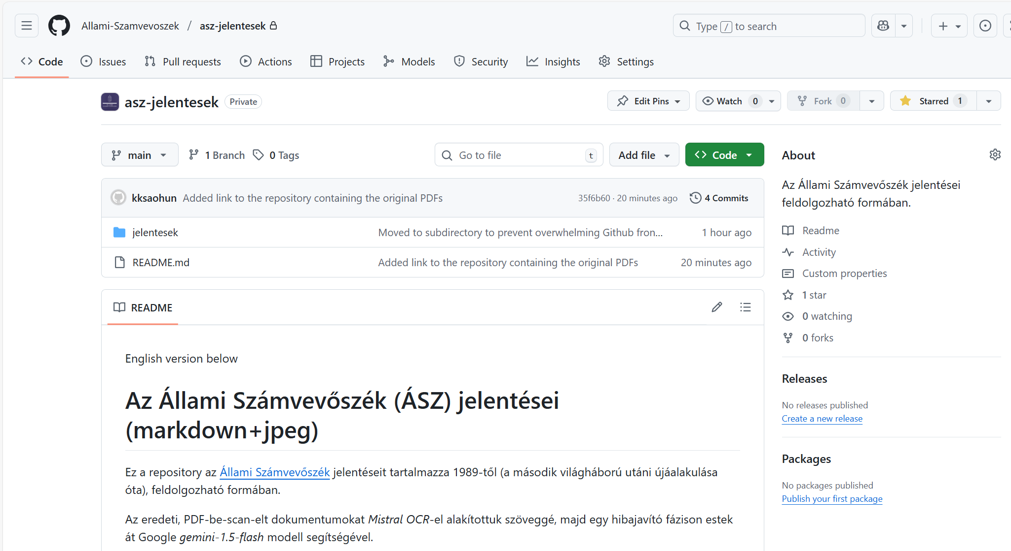
https://github.com/Allami-Szamvevoszek/asz-jelentesek

Slide 35
Why ask for JSON format?
Because if the AI simply responds with a paragraph of text, that cannot be easily aggregated.
LLMs are trained on JSON, so they perform better with it than – say – writing CSV.
For data analysts JSON is easy to read using tools like DuckDB, directly via SQL.
JSON can express 1:N relations (multiple categories, etc)

Slide 36
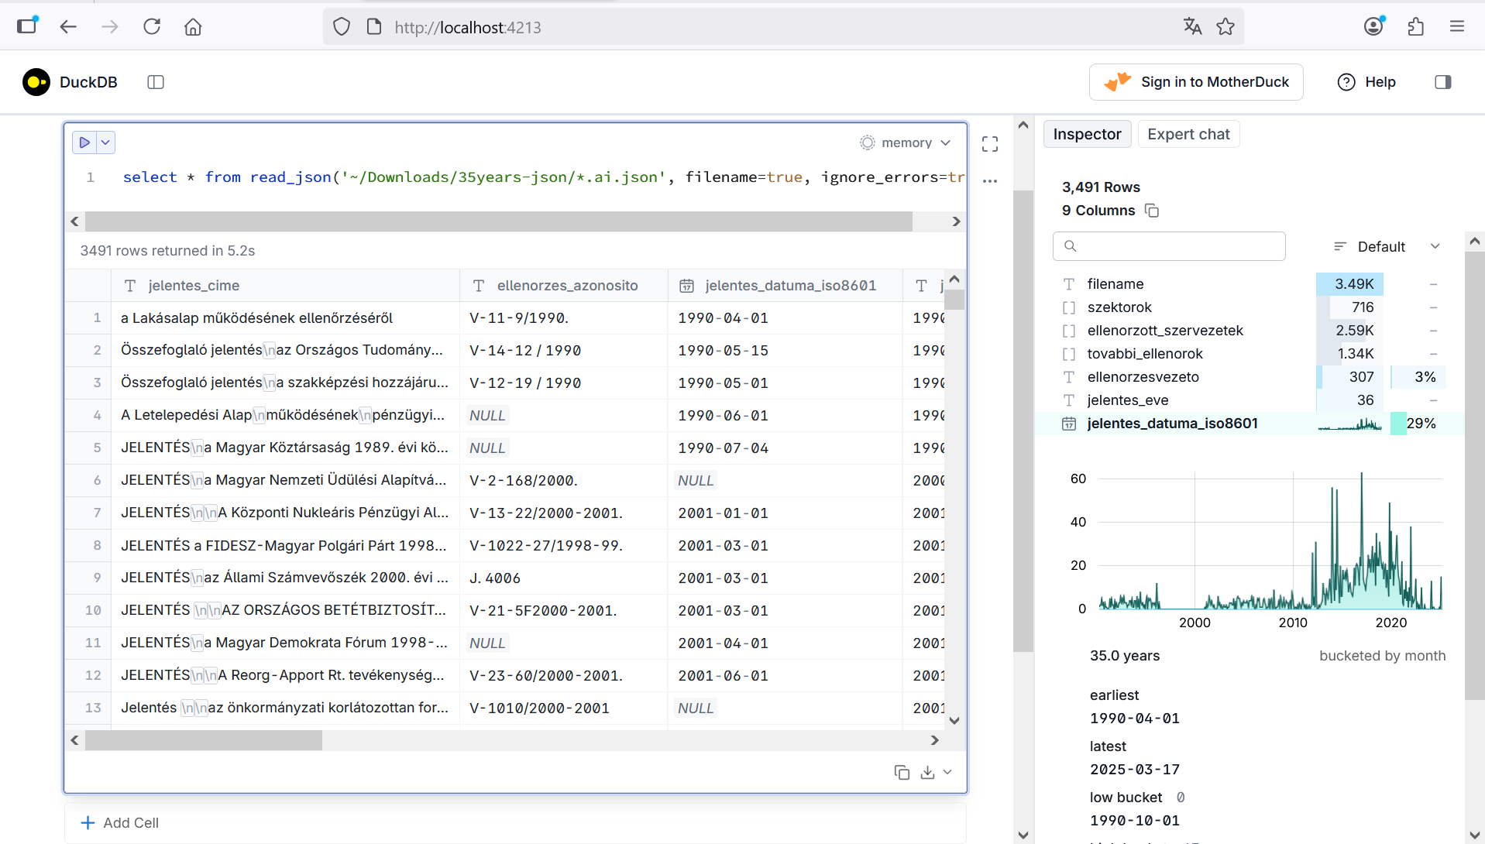

Slide 37
