Slide 1
Use of AI in Performance Audits
FUTURE REIMAGINED
Comptroller and Auditor General of India SAI India
Use of AI in Performance Audits — Future Reimagined | www.cag.gov.in

Slide 2



AI Transforming Governance
AI is not a future technology — it is already governing, deciding and shaping public life at massive scale.
$4.8T
67%
40%
~0.5%
Global AI Market by 2033
of Governments Deploying AI in Services
of Jobs Impacted by AI Globally
Increase in Global GDP by 2025–2030
UNCTAD Report
IMF World Economic Outlook
IMF 2025
OECD AI Policy 2025
SAI India · Use of AI in Performance Audits · PAS Annual Meeting, Budapest 2026

Slide 3


AI in Government Decision-Making: Promise vs Reality
The Promise
The Reality Check
Scale Analyse millions of cases simultaneously
Algorithmic Bias Replicates & amplifies inequity
Consistency Removes human variability & bias
Accountability Gap Who is liable for AI errors?
Cost Reduce processing costs by up to 80%
Data Quality Determines outcome quality
Insight Pattern recognition to the best of human ability
Over-reliance Erodes human judgement capacity
SAI India · Use of AI in Performance Audits · PAS Annual Meeting, Budapest 2026

Slide 4

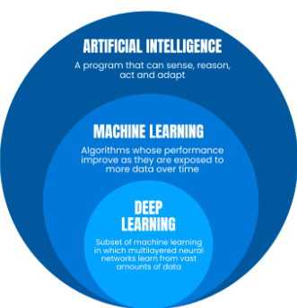
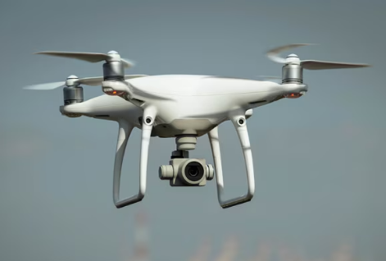
Major Technologies Used by CAG
Big Data Analytics
AI / ML Techniques
Drones & Computer Vision
Social benefits schemes audit
Volumetric analysis
Apriori ML algorithm
Geo-tagged site verification
Procurement data audit
Predictive analysis
SAI India · Use of AI in Performance Audits · PAS Annual Meeting, Budapest 2026

Slide 5
Applied AI in Performance Audits
Insights from Two Case Studies
Comptroller and Auditor General of India · www.cag.gov.in

Slide 6
Case Study 1: Duplicate Beneficiary Detection via Image Analytics
OBJECTIVE: Ensure that beneficiaries enrolled in welfare programs are genuine, unique, and not duplicated, using image-based analysis.
AI TECHNIQUES USED
PROPOSED APPROACH
Image Hashing Assigns unique hash to each photo; detects exact duplicates instantly
Detecting exact duplicate images
Identifying records without a valid human face
Face Detection Identifies images with no human face (ghost beneficiaries)
Detecting the same individual registered multiple times:
• Photos taken at different times
• Variations in appearance (clothing, hairstyle, background)
Face Recognition Matches same face across different photos — ageing, dress, background
OUTPUT: Structured list of duplicate and ghost beneficiary cases flagged for auditor review
SAI India · Use of AI in Performance Audits · PAS Annual Meeting, Budapest 2026

Slide 7
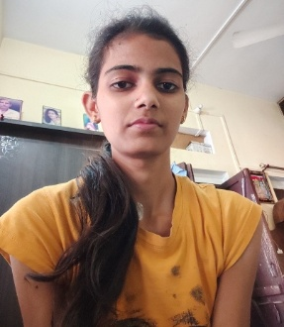




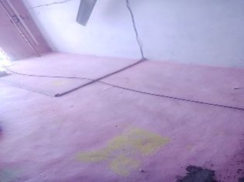





Finding Duplicate Beneficiaries — Input Photo Pool
These photos are processed through AI — image hashing, face detection, and face recognition — to identify duplicates and ghost beneficiaries.
SAI India · Use of AI in Performance Audits · PAS Annual Meeting, Budapest 2026

Slide 8
Finding duplicate beneficiaries with image analytics
Potential Duplicate beneficiaries
Potential Ghost beneficiaries
SAI India · Use of AI in Performance Audits · Future Reimagined

Slide 9
Case Study 2: Audit of Housing Scheme via Drone (PMAY)
OBJECTIVE: Verify construction progress and stage of houses against government records and assess accuracy of payment disbursements.
PILOT SCOPE
AI / ML TECHNOLOGY STACK
Location: One pilot district
UAV / Drone Survey: Geo-tagged aerial images of house sites
Computer Vision: Classifies construction stage: Completed / Roof / Plinth / Not Started / Proposed
Coverage: Urban: 10 sq. km | Rural: 5 sq. km
GIS & Geospatial Analytics: Maps and matches locations with government records
Survey Period: January 2026 (1 month)
Data Analytics: Detects duplicates; checks stage mismatch and payment vs progress
Houses Covered: Urban: 26,918 | Rural: 26,336
Immersive Map Platform: Links images to records; provides case-level evidence for audit
SAI India · Use of AI in Performance Audits · PAS Annual Meeting, Budapest 2026

Slide 10
AI-Driven Verification Workflow & Outcomes
HOW AI VERIFICATION WORKS
VERIFICATION OUTCOMES (COMBINED)
Drone Capture UAV surveys capture geo-tagged images of all houses using GPS locations from records
Houses covered by drone survey
Urban: 10,411 | Grameen: 209
Verified as Consistent
5,862
AI Stage Classification Computer vision classifies each house: Completed/ Roof/ Plinth/ Not Started.
Data matches drone findings
Flagged for Review
1,441
Cross-Match with Govt. Portal AI results compared with government records for each beneficiary
Data does not match drone findings
Ambiguous / Not Visible
3,307
Flag Exceptions Mismatches and duplicate locations are flagged for review
House not visible or data unclear
SAI India · Use of AI in Performance Audits · PAS Annual Meeting, Budapest 2026

Slide 11
Key Audit Findings — AI-Identified Issues
Premature Completion Marking (Stage Mismatch)
1
Records show house as Completed with full payment released; Drone survey shows house not started or still under construction.
Impact: Public funds released for incomplete work.
Inspection Inconsistencies (Records Not Updated)
2
Drone confirms house as Completed; records show a lower stage inspection or records not updated.
Impact: Unreliable data; weak accountability and traceability.
Duplicate GPS Coordinates (Data Analytics)
3
Analysis identified beneficiary pairs with identical latitude/longitude coordinates, indicating possible duplicate or fraudulent records.
Impact: Flagged cases require field verification before final conclusion.
SAI India · Use of AI in Performance Audits · PAS Annual Meeting, Budapest 2026

Slide 12
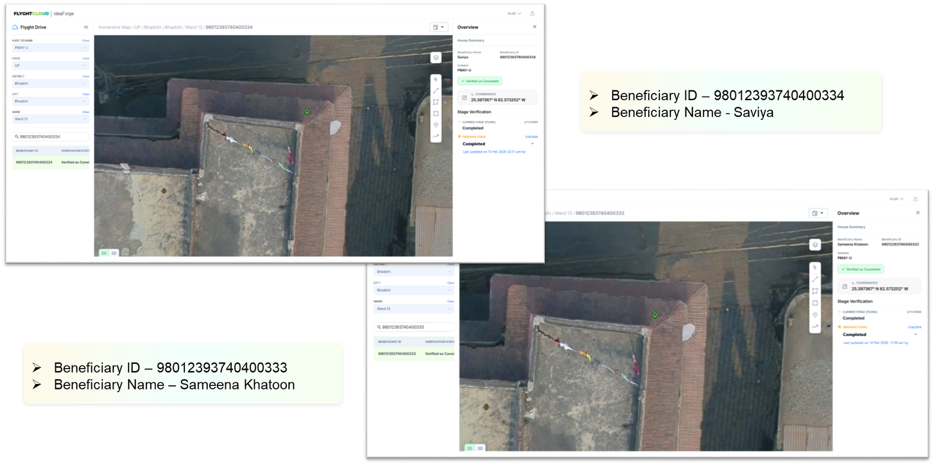
Potential Duplicate Cases — GPS-Based Evidence
The below entries represent potential duplicates case identified through data analytics using latitude/longitude. Field-level verification is required before final conclusion.
BENEFICIARY ID | BENEFICIARY NAME | WARD
9801239374 1500155 9801239374 0500493 | MANJU DUBEY ARADHANA | 25 14
9801239373 9300362 3098012398 2079043 | MOHD ADIL KHAN MOHD ZAVED KHAN | 8 12
9801239374 0100537 9801239374 0800064 | PARVEJ ALAM RIYAZUDDIN | 10 17
9801239374 0400334 9801239374 0400333 | Saviya Sameena Khatoon | 13 13
9801239374 0400524 9801239374 0800142 | SONI DEVI SUBHASH CHANDRA YADAV | 13 17
9801239373 9300469 9801239374 0700203 | TAUSIF ANSARI JAMILA BANO | 2 16
SAI India · Use of AI in Performance Audits · PAS Annual Meeting, Budapest 2026

Slide 13
AI-Driven Audit: Coverage, Evidence, and Cost Efficiency
OVERALL AUDIT IMPACT
COST AND TIME EFFICIENCY
Full Coverage of Cases AI-driven drone audit enables full coverage — not feasible through manual field inspection
Drone Survey ~20 days
Data Processing & Analysis ~10 days
Strong, Verifiable Evidence Geo-tagged drone images provide time-stamped, reliable proof linked to each record
Total Time ~30 days
Approx. Cost EUR 95,000 – 100,000 (~EUR 6,500 per sq. km)
Scalable Methodology Approach can be replicated across regions and programs
SAI India · Use of AI in Performance Audits · PAS Annual Meeting, Budapest 2026

Slide 14
SAI India AI Applications
Broader Portfolio of AI-Enabled Audit Tools
Comptroller and Auditor General of India · www.cag.gov.in

Slide 15


The Direct Tax Audit
SCALE OF THE PROBLEM
250+ pages per case
~100 data entries/case
60–75% current coverage
Tax return, audit report, financial statements, assessment order, computations, notices
Manual tools require ~100 data entries per case — time-consuming and prone to errors
With a shift toward 100% audit, there is limited capacity for deeper analysis
Opportunity: An AI-based solution can ingest documents, extract key data, and automatically validate rules — enabling faster, more complete, and more reliable audits.
SAI India · Use of AI in Performance Audits · PAS Annual Meeting, Budapest 2026

Slide 16


Transformative Use: Income Tax Assessment Audit (AI Agent)
Analyse Income Tax returns filed by automating first-level verification checks
1
2
3
4
Document Ingestion
LLM-Driven Extraction
Rule Validation
Output
OCR and extraction pipeline for Income Tax returns and documents
High-accuracy extraction and matching of dates, names, and anomalies
Generate structured error reports for validation by Auditors
Apply rules and business logic to extracted data
Impact: Sample → 100% cases audited; 40% reduction in time; 30% cost savings
SAI India · Use of AI in Performance Audits · PAS Annual Meeting, Budapest 2026

Slide 17
Capacity Building Initiatives
SAI India is strengthening internal AI capabilities through partnerships with leading academic institutions and international organizations.
AI, Data Science & Cyber Security Audit
AI in Environmental Audit
Data-Driven Audit Using AI & ML
Programme with Indian Institute of Technology Madras (UN AI Centre of Excellence) — 10-month online.
Specialized certification programme with Indian Institute of Technology Madras, focused on AI applications in environmental auditing.
Short-term, hands-on certification programme with Indian Institute of Technology Delhi.
Joint AI Audit Tool Development
GIS & Remote Sensing for Audit
AI Champions Programme
Collaborative development of AI-powered audit tools: Risk analysis models for Documentation
Specialist training in AI technologies for audit applications, in partnership with technical institutes.
WGDT-linked programme to identify and develop internal AI champions who drive adoption across SAI India.
SAI India · Use of AI in Performance Audits · PAS Annual Meeting, Budapest 2026

Slide 18
Thank You
Comptroller and Auditor General of India | SAI India
PAS Annual Meeting · Budapest · March 2026
www.cag.gov.in

