Slide 1
PAS Annual Meeting
Experiences on Auditing AI & Algorithms

Slide 2
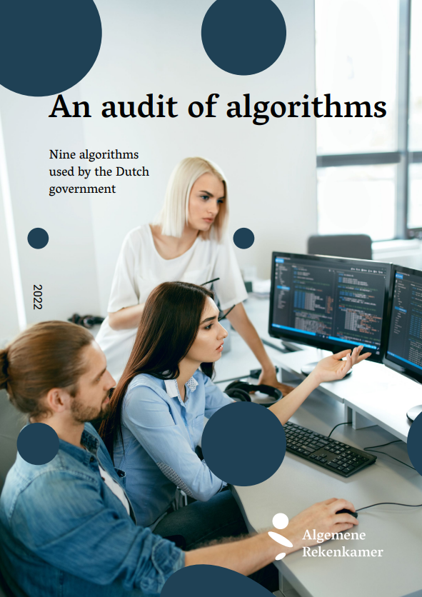
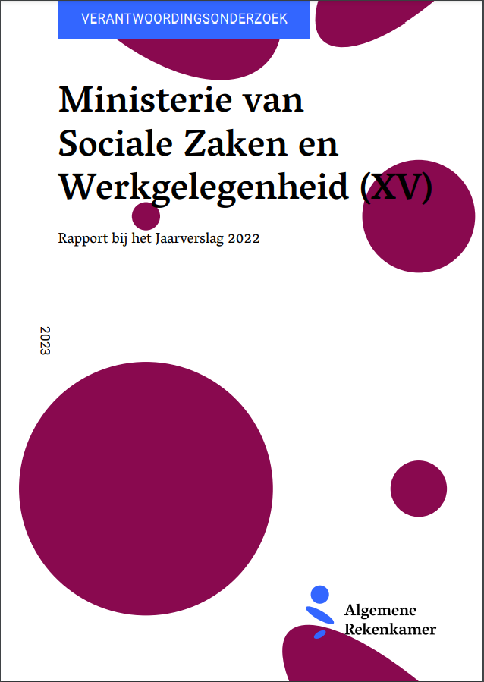
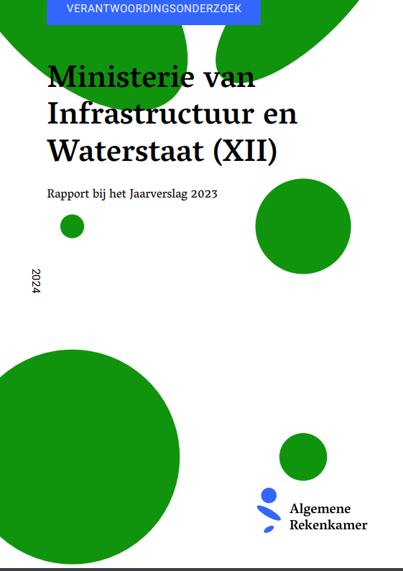
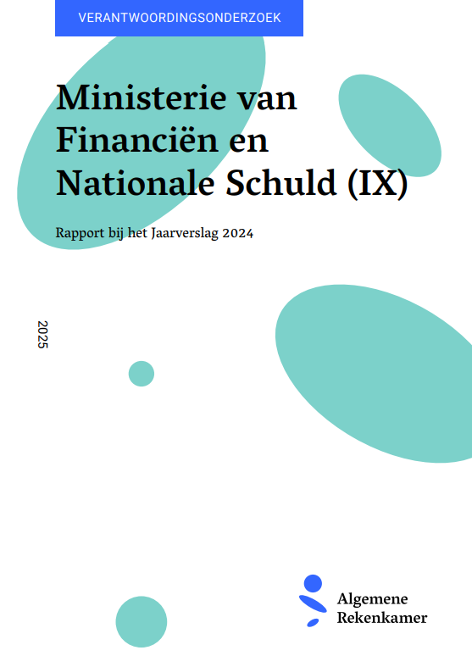
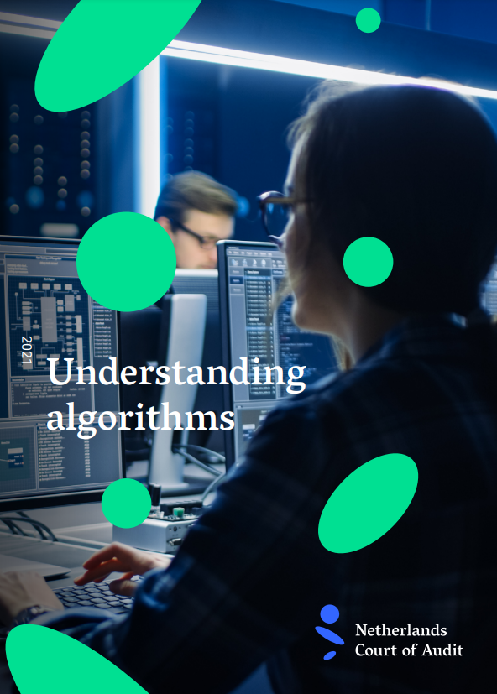

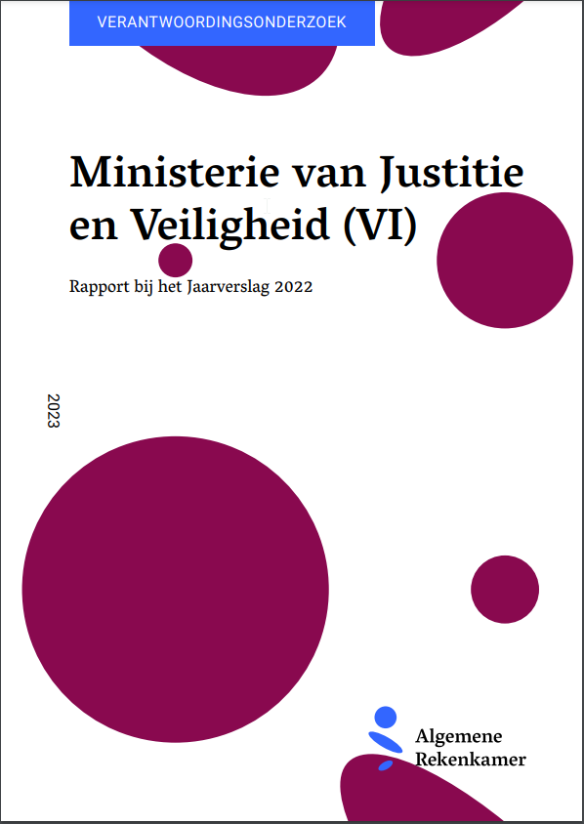
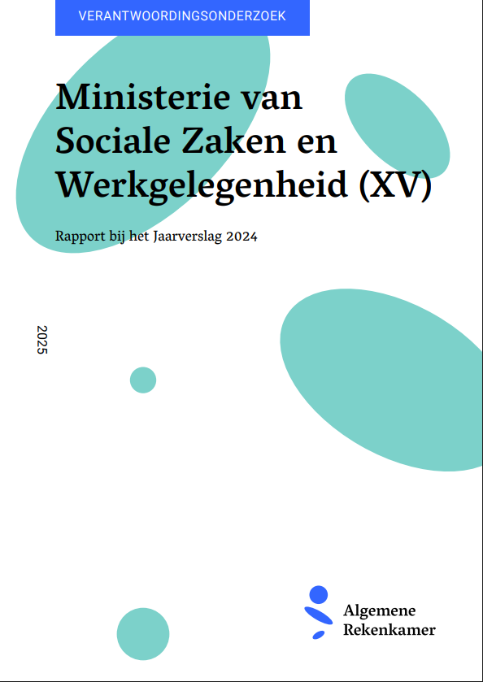
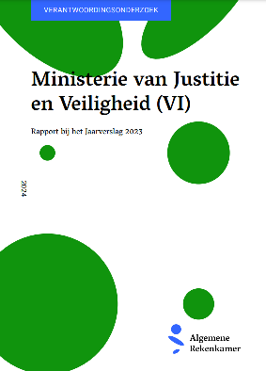
Our experiences with auditing AI and algorithms
Development Audit Framework for algorithms (2021)
Audit of 9 algoritmes (2022)
Annual audit (2023)
Annual audit (2024)
Annual audit (2025)
Annual audit (2026 - upcoming)

Slide 3
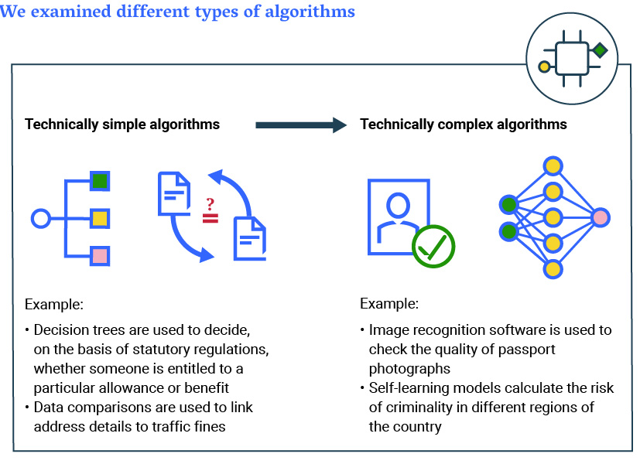
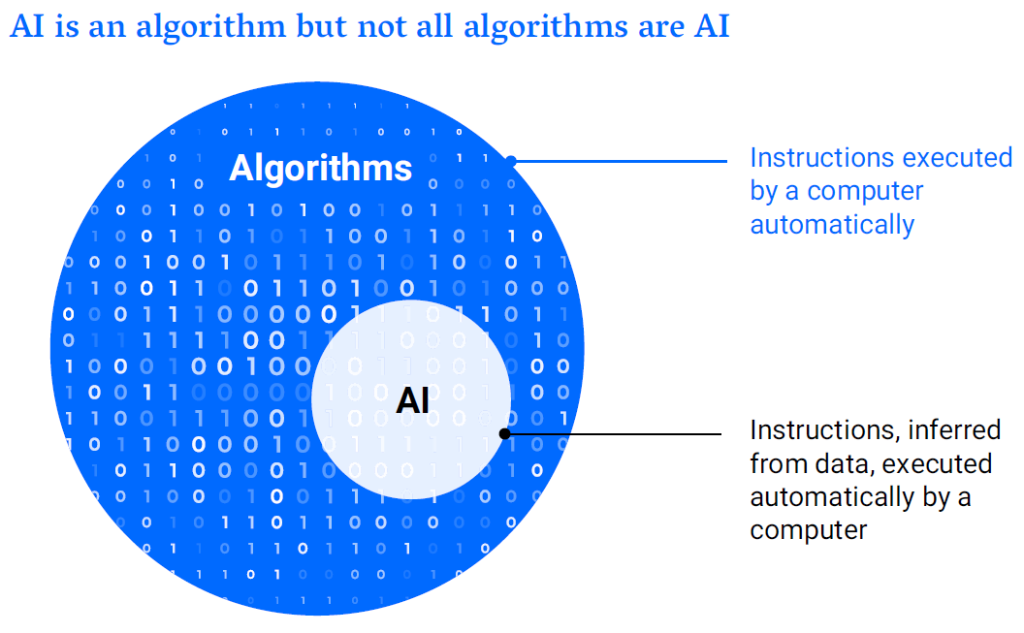
AI and algorithms in our audits

Slide 4
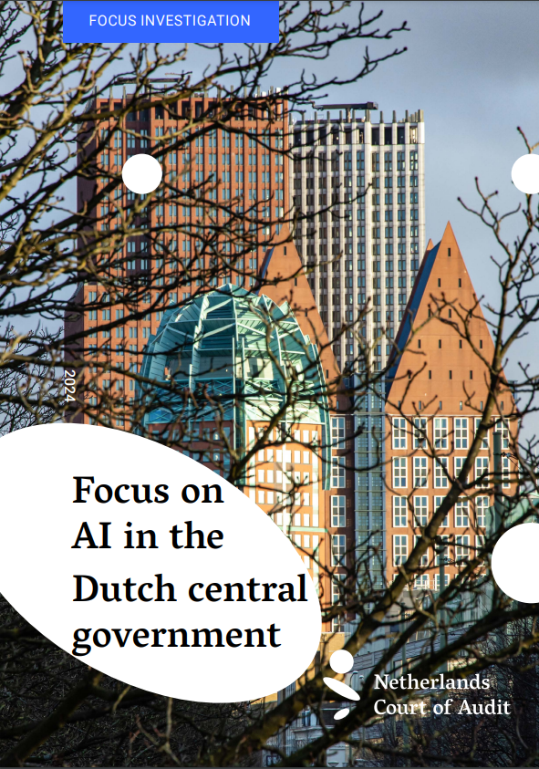
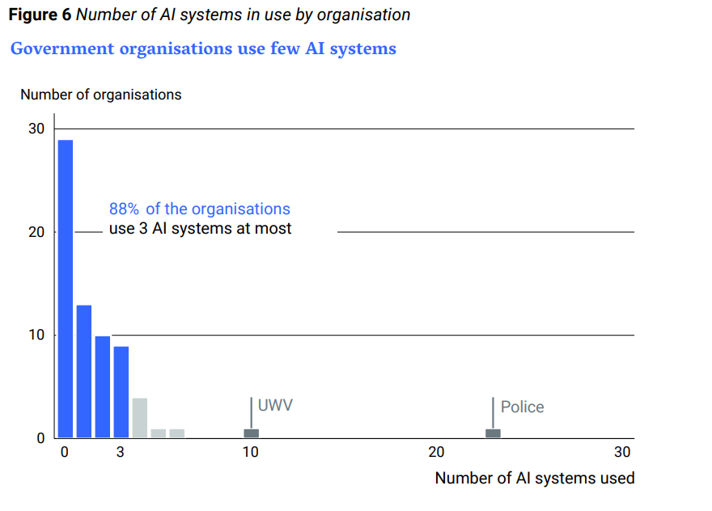
Landscape of AI in the Dutch central government

Slide 5
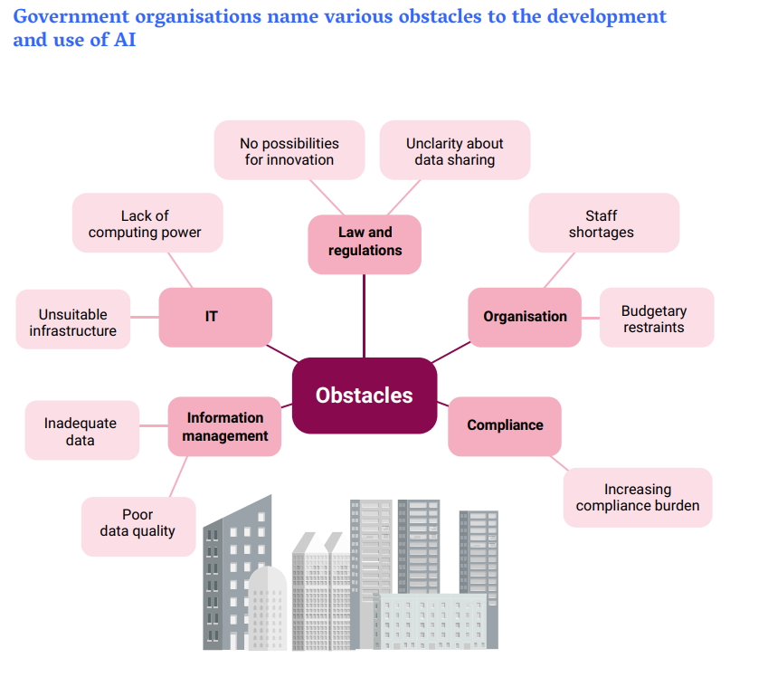
Key findings of Dutch AI landscape
AI is used for wide variety of tasks, but mostly internal oriented
Risk assessments of AI systems not always done
Most AI indicated as “minimal risk”
Performance of AI is still unclear
Various obstacles limit the development and deployment of AI

Slide 6
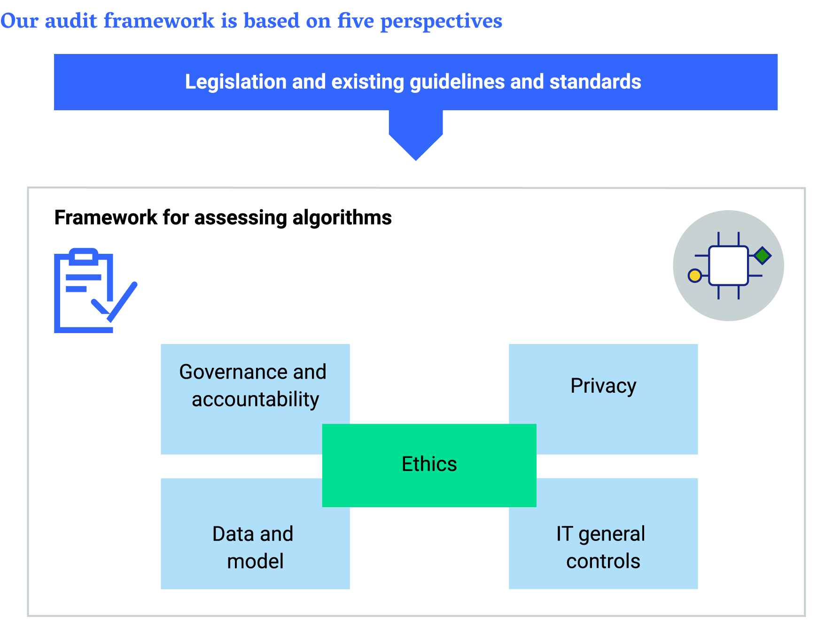
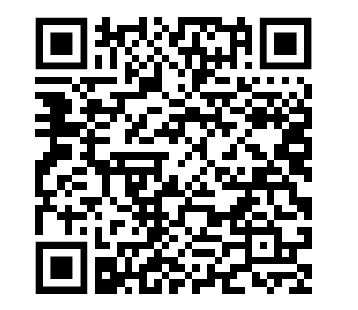
Audit framework
https://english.rekenkamer.nl/publications/publications/2021/01/26/audit-framework-for-algorithms

Slide 7
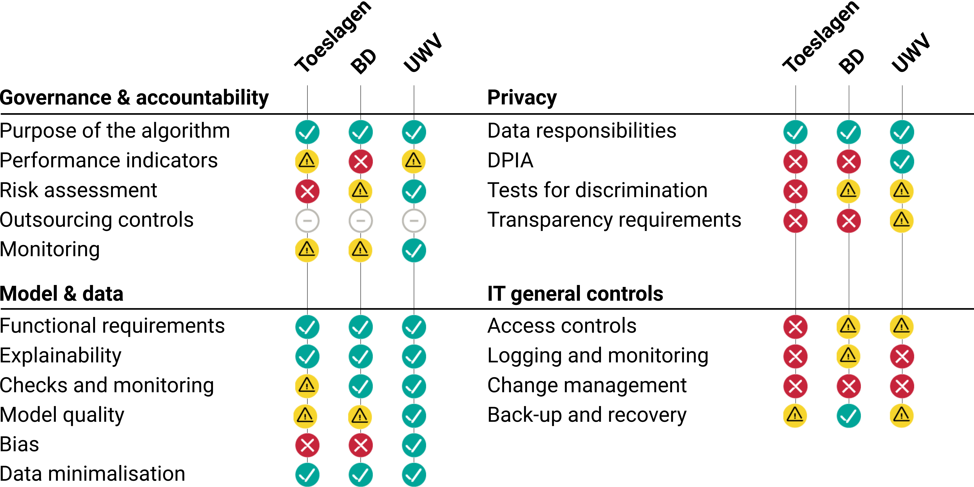
Last year’s audit

Slide 8
Key common risks and takeaways
Algorithms can improve effectiveness of governments, but common risks often not mitigated.
Problem often lies not in the complexity of the technology itself, but in a lack of controls.
The recurring issues are directly linked to governance, IT security, and a failure to address bias proactively:
1. Poor governance and accountability
2. Inadequate IT General Controls
3. Bias checks
4. Non-compliant with data protection

Slide 9
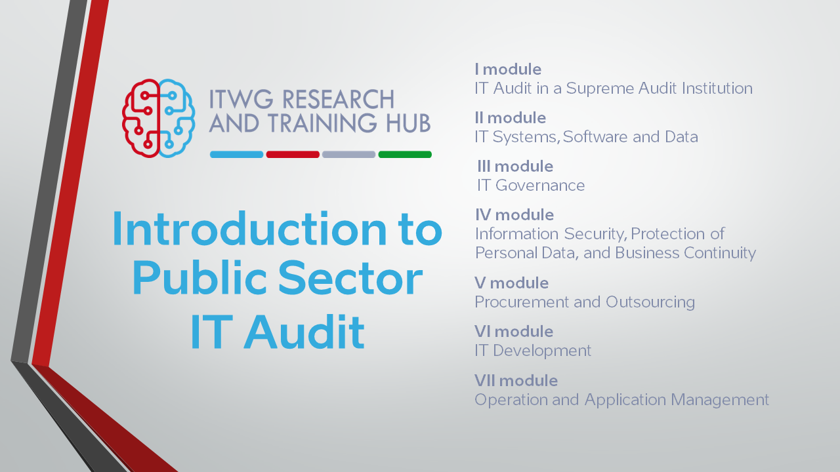
Upcoming training course on Auditing AI for SAIs

Slide 10
Thank you for your attention! Stay connected! c.vannoordt@rekenkamer.nl www.linkedin.com/in/colin-van-noordt/

