Slide 1



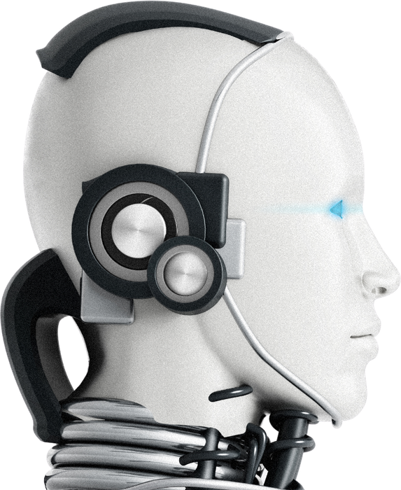
Leveraging AI in Performance Auditing:
The State Audit Office of the Kingdom of Thailand
17th INTOSAI Performance Audit Subcommittee Annual Meeting
Budapest, Hungary
24 – 25 March 2026
The State Audit Office of the Kingdom of Thailand

Slide 2


AI & Generative AI
2

Slide 3

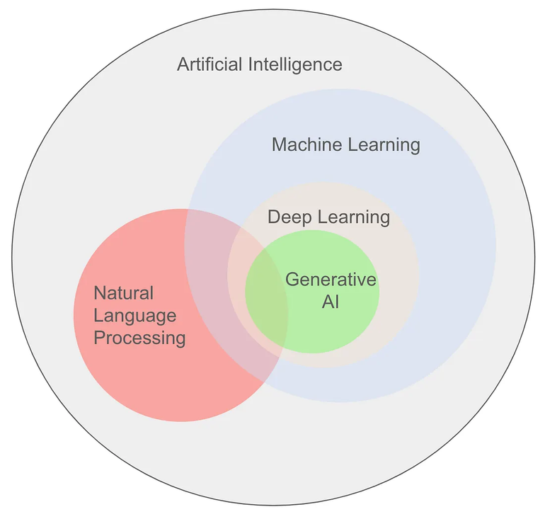
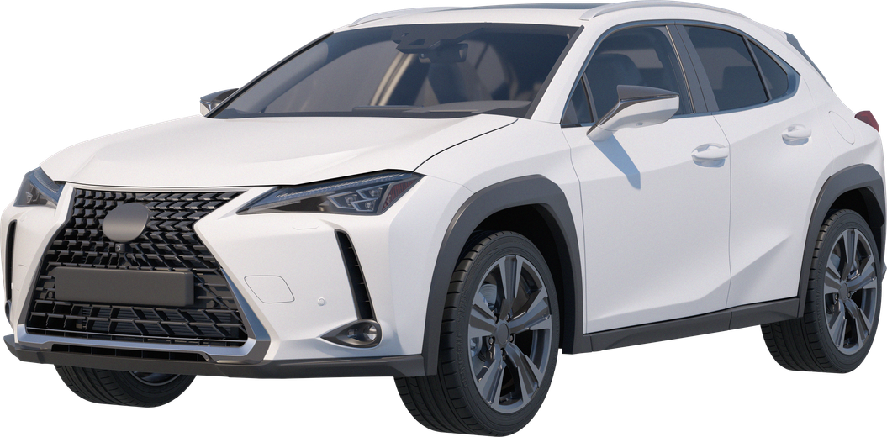
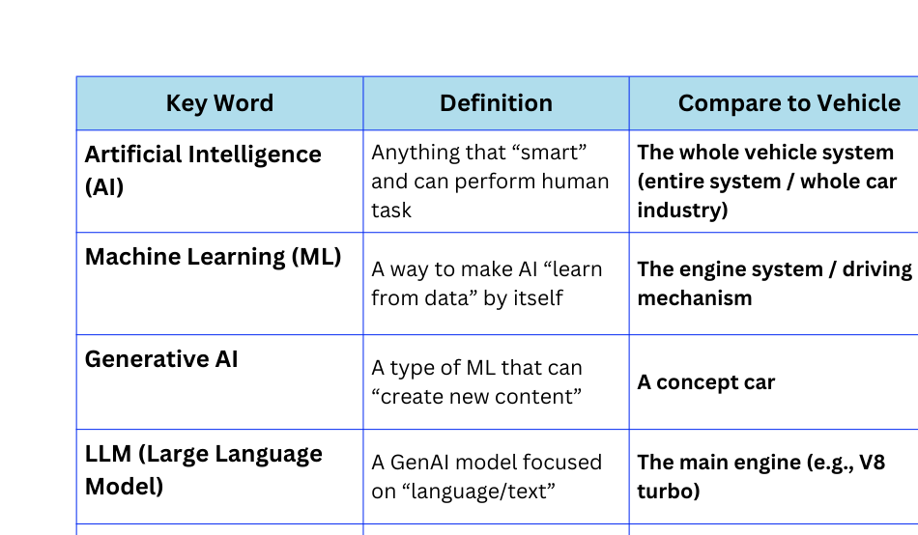
Understanding the Structure: AI > ML > GenAI
LLM
3
source: https://medium.com/analytics-vidhya/what-is-generative-ai-9c34cfa0fd6b

Slide 4
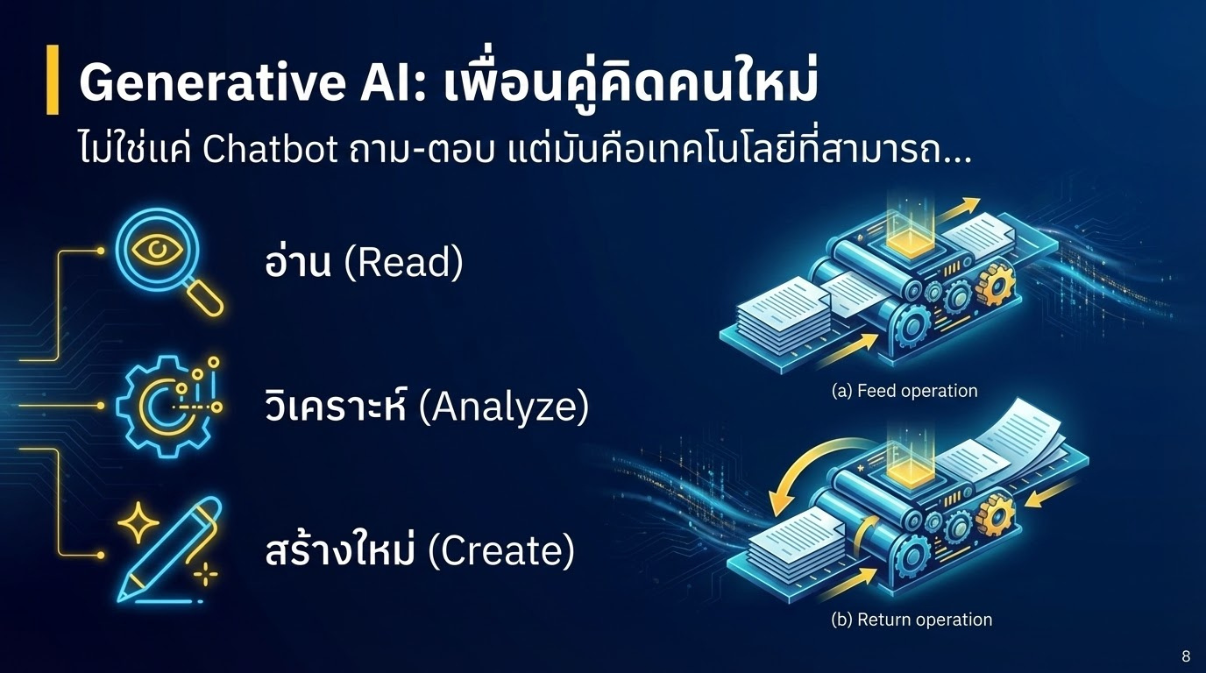
Generative AI: A New Thinking Partner
Not just a Q&A chatbot,
But a technology that can…
Read
Analyze
Create
4

Slide 5






Powers of Generative AI in Auditing
1.Read at large scale
2. Analyze Against Criteria
3. Draft Reports
Read a 100-page PDF contract and summarize the key points within 10 seconds.
Compare facts with regulations/laws to identify irregularities.
Transform “data” into an “audit report draft.”
5

Slide 6

Core Component: LLM (Large Language Model)
The V8 Turbo Engine
LLM is a model trained on massive amounts of text data from across the internet.
Examples
GPT-5.1 (OpenAI)
It enables understanding of:
Gemini 3.0 Pro (Google)
•
Human language (Thai/English)
Claude 3.5 (Anthropic)
•
Context
•
Reasoning
6

Slide 7

Governance & Risks
7
37

Slide 8

1. Data Privacy (Official Confidentiality)
Key Rule: Do not input confidential information into public AI systems
•
PDPA
•
National security information / Official confidential information
•
Solution: Use an Enterprise Version or always anonymize identifiable data before use
8

Slide 9

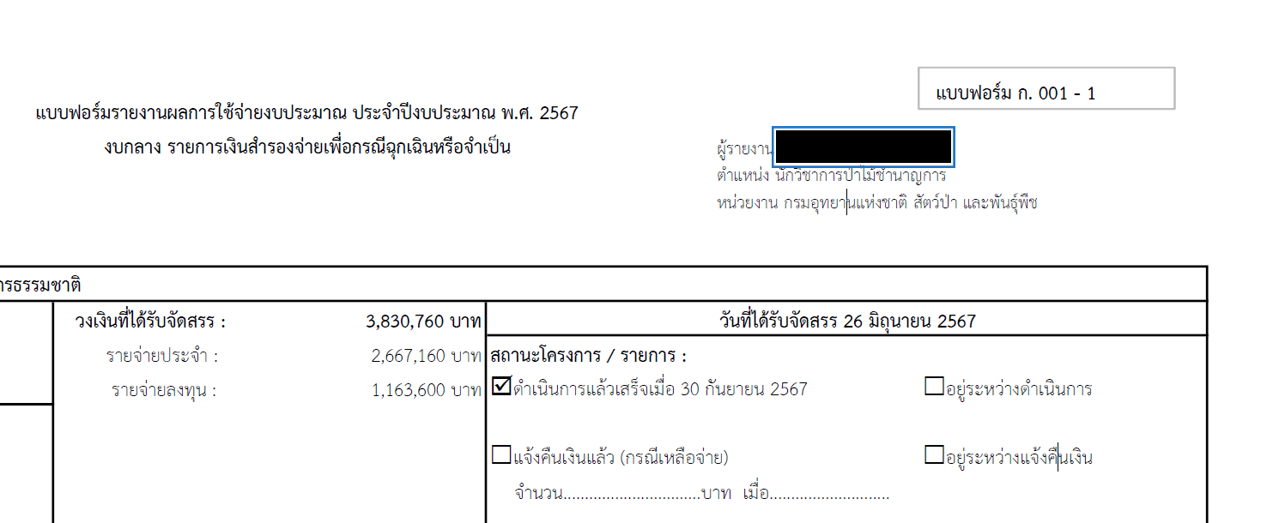
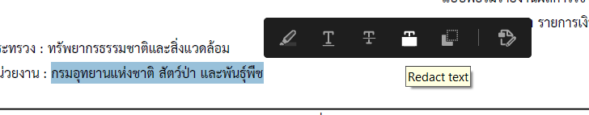
How to Redact Information in a PDF File
Select the text or image in the PDF file, then right-click and choose “Redact.”
9

Slide 10

2. Hallucination
Trust but Verify
•
AI can fabricate information confidently (Confident Lies).
“AI is like a very hardworking and intelligent intern but sometimes it makes guesses. As supervisors, we must always review its work.”
•
Numbers legal provisions or sections may be inaccurate.
•
Solution: Always verify against original source documents. Do not trust 100%.
10

Slide 11
3. Accountability
AI is only a tool.
•
Review and approval results remain the responsibility of humans.
•
Human-in-the-loop: Humans must always be the final decision-makers.
•
11

Slide 12

Prompt Engineering
(Garbage In, Garbage Out)
12

Slide 13




Prompt Writing Formula (4 Components)
1. Context
2. Task
Who are you?
(e.g., “You are an expert in auditing procurement regulations.”)
What should be done?
(e.g., “Identify inconsistencies in this document.”)
3. Constraint
4. Output
What are the limitations or boundaries?
(e.g., “Refer only to the 2017 regulations.”)
What format do you want the result in?
(e.g., “Present the answer in a comparison table.”)
13

Slide 14
Example: Bad vs Good Prompt
Bad Prompt
Good Prompt
“As an auditor (Context), please analyze and identify potential specification lock in risks (Task) in this TOR focusing on the qualifications required of bidders (Constraint). Summarize the findings in bullet points (Output).”
“Please take a look at this document and see if there’s anything wrong.”
Result: Too broad; AI responses may lack focus and precision.
Result: Clear, focused, and immediately usable.
14

Slide 15
Advanced Technique: Think Step-by-Step
Instruct the AI to “Think Step-by-Step.”
“…Before answering analyze the relevant facts step by step first. Then compare them with the factual information and finally summarize the audit findings.”
Benefit: Reduces hallucinations and improves the accuracy and rigor of the review process.
15

Slide 16

Case 1: TOR Review (Procurement Audit)
Mission: Identify “Locked Specifications”
TOR documents for procurement often contain technical details that may create conditions favoring specific bidders.
Existing Problem:
Requires subject-matter experts in specific fields or takes significant time to carefully review and compare specifications.
16

Slide 17
Case 1: TOR (Procurement Audit)
Prompt:
“Please analyze and identify three potential specification lock-in risks in this document, considering issues such as unnecessarily restrictive qualification requirements or indirect brand referencing.”
17

Slide 18
Case 1: AI Result (Possible Findings)
AI Output
3 potential risk indicators identified
•
Service location requirement: Clause 4.2 requires bidders to have a service center within 1 km of the agency, which may limit competition.
•
Specific technical specifications: Requires the use of X-Series engines only (single distributor).
•
Past experience requirement: Bidders must have previously worked with this agency (may exclude new entrants).
18

Slide 19




Case 1: Results from Using AI Assistance
Speed
Detection
Fairness
AI helps flag potential issues for auditors to investigate further no more searching for a needle in a haystack.
Reduced document scanning time from 3 hours to 3 minutes.
Increases the likelihood of detecting unfair practices in competition.
19

Slide 20

Case 2: Reviewing Expense Transactions
Mission: Detect Anomalies
Transaction data ranging from approximately 10,000 to 1,000,000 rows in Excel.
Current issue: Sampling methods may fail to detect hidden irregular transactions.
20

Slide 21



Case 2: Workflow (Excel + AI)
3. Upload to AI (Data Analysis Mode)
1. Export Excel
2. Save as CSV
“Identify transactions with vague descriptions transactions with amounts ending in 000 or transactions that occurred on public holidays.”
21

Slide 22
Case 2: AI Result (Possible Findings)
Suspicious Transaction Identified (Flagged Transactions):
AI Output
Date | Descriptions | Amount | AI Remark
12 Mar (SUN) | Banquet catering expense | 50,000 | Holiday /High Amount / Unclear explanation
15 Apr (SAT) | Gift purchase expense | 20,000 | Songkran festival / Possibly non-official expense
22

Slide 23
Case 3: Reporting Assistant (Reporting)
Mission: From Working Papers (Data Collection Summary) to Final Report
The auditor has completed the audit procedures, but often spends significant time on:
  “Processing the information”
  “Identifying the key issues”
  “Organizing and structuring the wording”
Problem :
  Spoken vs. written language
23

Slide 24



Case 3: AI Result (Possible Outcome)
Input (Notes)
“Found that the computer purchase price was 20,000 THB
higher than the reference price. No price comparison documents were provided. The officer stated that it was urgent.”
Output (Draft Report):
“From the audit, it was found that the computer procurement price exceeded the reference price by 20,000 THB, and no evidence of price comparison was presented. This may not be in compliance with the Public Procurement Act…”
24

Slide 25
Case 3: Tone & Style Adjustment
We can instruct AI to adjust the tone and style:
“Please revise this text to be formal in tone (Formal) polite yet concise and include a reference to Procurement Regulation No. 123.”
Result: Reduced document editing time, allowing auditors to spend more time reviewing other matters.
25

Slide 26
Case 4: Coding Assistant (for Complex Tasks)
When no-code tools are not sufficient
“Please write Python code to analyze the correlation between annual budget expenditure and PM2.5 levels in Chiang Mai Province over the past 10 years.”
Sometimes more advanced analysis is required
such as analyzing satellite-based PM2.5 data.
We can ask AI to help write Python or JavaScript (GEE) code.
26

Slide 27
Why Artificial Intelligence Cannot Fully Replace Human Auditors
Contextual Judgement: Decision making in nuanced and sensitive contexts
•
•
Physical Verification: On-site inspection and physical verification (e.g., counting materials, assessing quality)
Interview: Inquiry through testimony and observing the auditee’s body language
•
Responsibility: Legal accountability (AI cannot be legally liable)
•
27

Slide 28






Formula for Success
People
Process
Technology
Adjust audit processes to support AI (do not simply apply AI to existing manual processes).
Develop Prompt Engineering skills and Digital Mindset.
Select tools that are secure and appropriate for the job (Secure AI).
28

Slide 29
"AI will not replace auditors…
but auditors who know how to use AI
will replace those who do not."
29

Slide 30
Showcase
Example:
The Practical Application of AI & Generative AI in Auditing
30

Slide 31
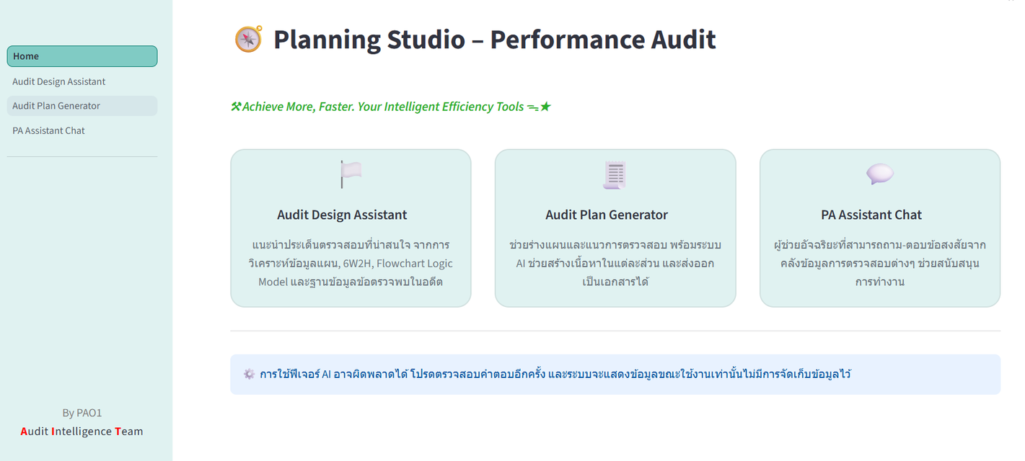
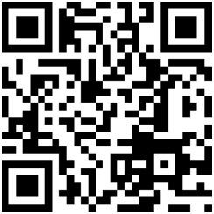
Demo: Prototype
https://pa-ai-assistant.streamlit.app
หรือ https://2cm.es/1mrn1
31

Slide 32
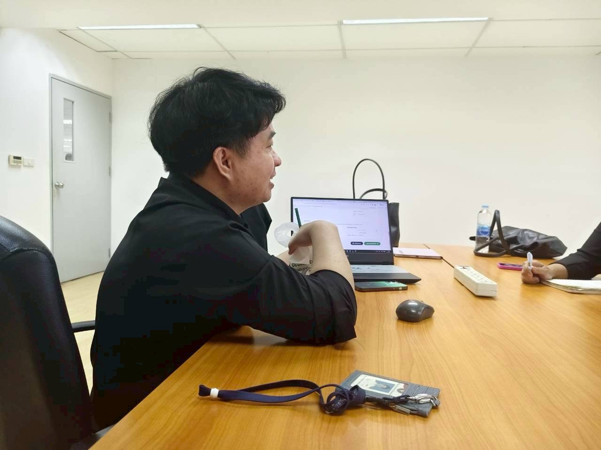
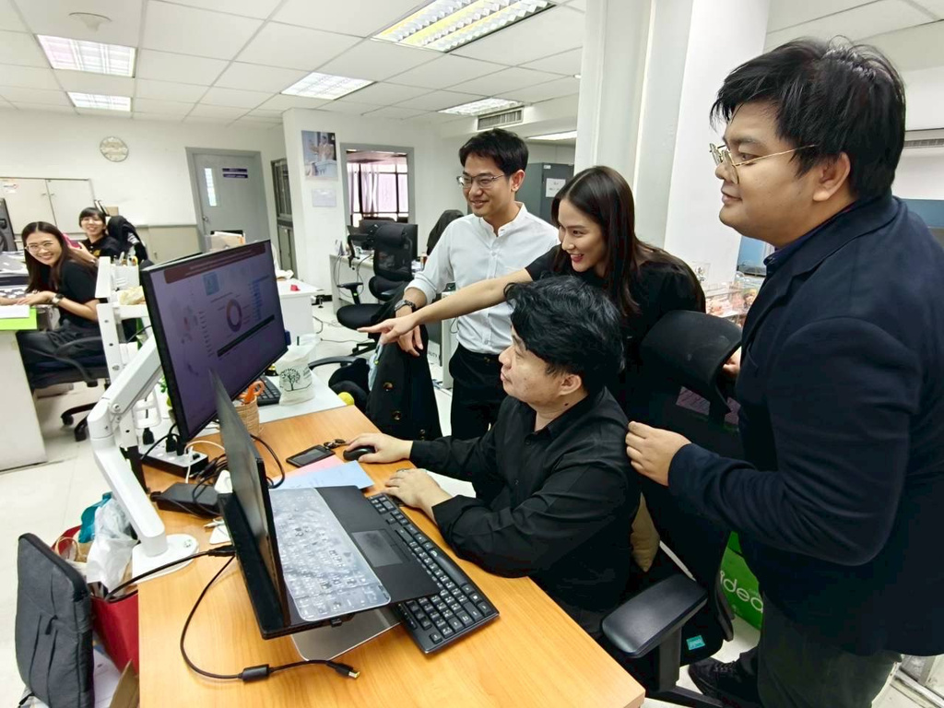
The concept of applying Artificial Intelligence (AI) and Generative AI in auditing through a Web Application is an initiative developed by Mr. Worapong Polkongkaew, Senior State Audit Officer, Office of Performance and Operational Audit 1, with the objective of enhancing the audit process to be more efficient accurate and evidence-based. The initiative proposes the development of a Web Application that integrates AI and Generative AI to support auditors throughout all stages of the audit process, from audit topic selection to audit planning and the provision of academic advisory support.
32

Slide 33

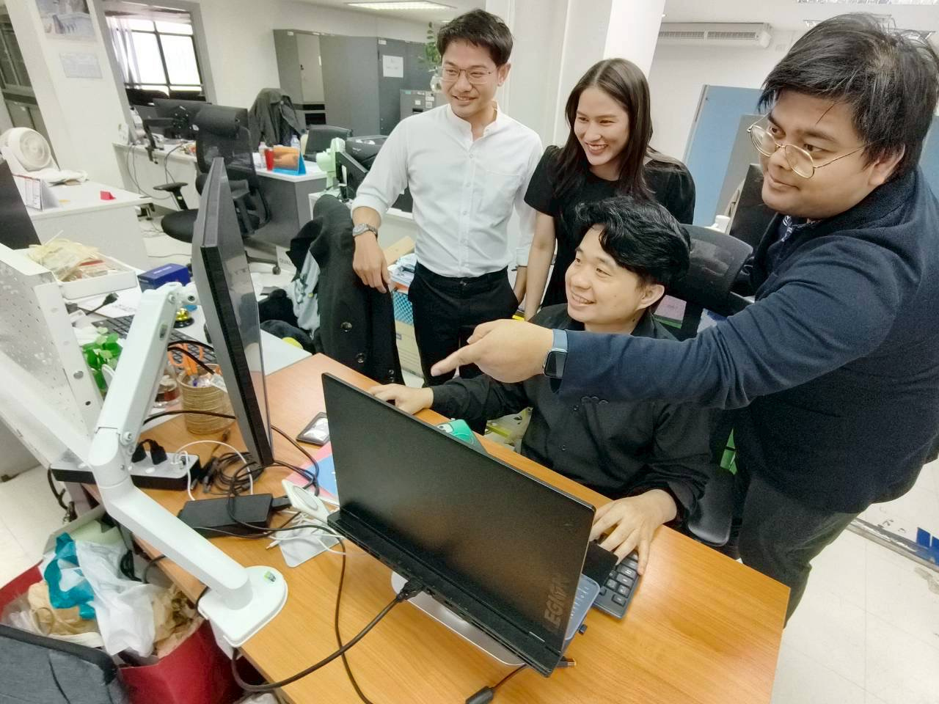

1. Audit Topic Selection
The current problem is that audit topic selection cannot yet be systematically linked to public expenditure data, particularly data from the GFMIS, which is the main expenditure database. At the same time, detailed project information, performance reports, and many supporting expenditure documents remain in PDF format and cannot be directly used for structured analysis.
The Web Application therefore applies AI to support this process by using OCR technology to convert PDF files into data that can be processed
and to organize the information into a standardized format. It then uses Generative AI or knowledge synthesis tools, such as NotebookLM, to summarize key content, analyze risk issues, and link data among
“budget implementation outcomes ” enabling audit topic selection
to be supported by evidence and based on actual data
(data-informed selection).
33

Slide 34

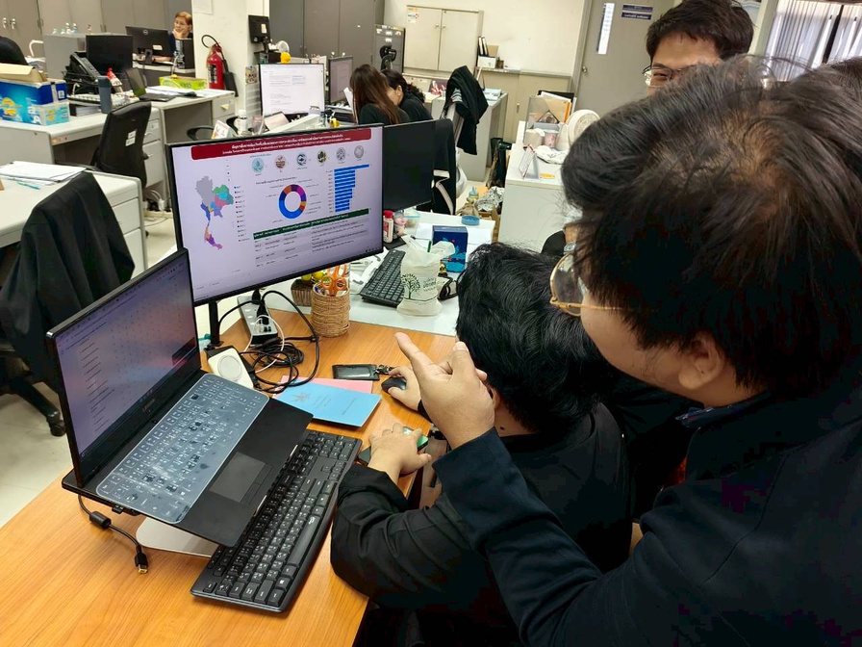
2. Audit Planning
Another important problem is that many auditors are still unable to clearly identify which issues should be examined and where the key risks are, due to the lack of systematic analysis and synthesis of past audit reports. As a result, the planning process is delayed, taking approximately 3–4 months before the audit framework can be clearly defined.
The Web Application therefore develops a tool called the Audit Design Assistant to help analyze information from work plans in the form of 6W2H, process flowcharts, logic models, and a database of past findings. The system processes the data and proposes interesting audit issues, identifies risk points and systemic gaps, enabling auditors to define the audit scope more quickly and with supporting reasons.
In addition, there is an Audit Plan Generator tool that assists in preparing the audit plan, defining audit criteria, and automatically creating document outlines for each section, together with an AI system that helps draft content under each heading and can immediately export it as an official document. This helps reduce the time required to prepare the plan and increases consistency in document formats across the organization.
34

Slide 35

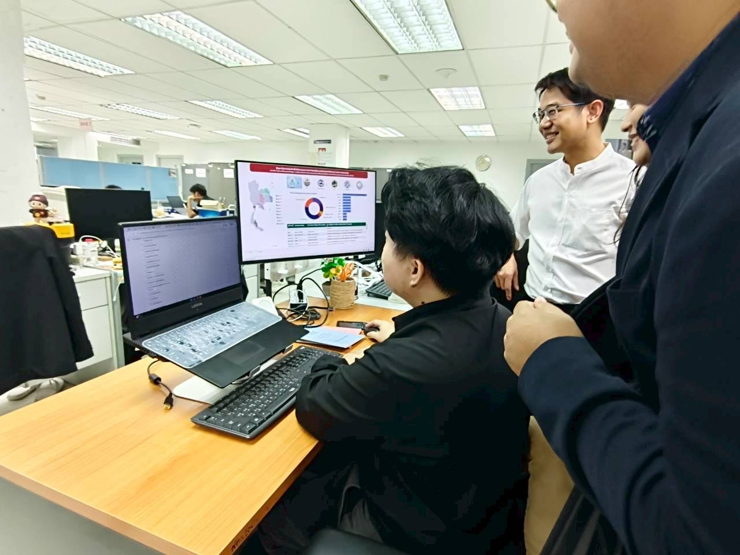
3. Operational Support During Audit Execution
The system also includes a PA Assistant Chat, which is an intelligent assistant capable of answering questions from an audit knowledge repository, including audit guidelines, auditing standards, past findings, and case studies. Auditors can raise inquiries in real time, which helps reduce the burden of information searching and supports decision-making based on accurate knowledge.
35

Slide 36
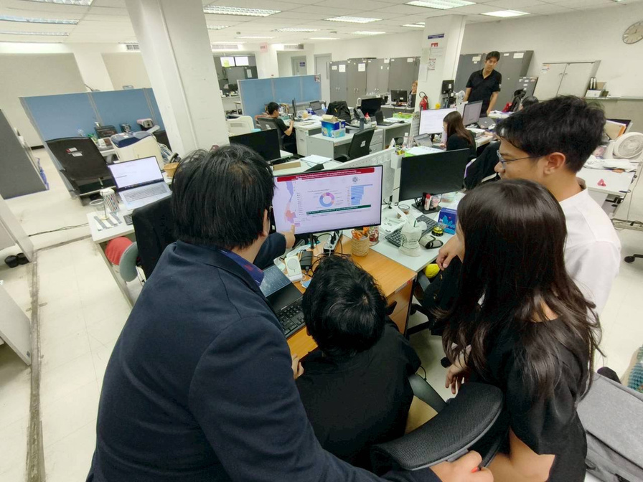
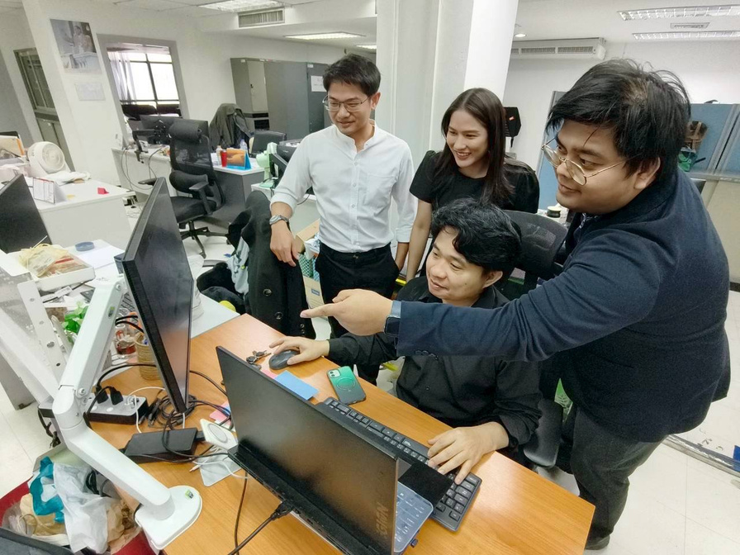
Expected Outcomes
The development of a Web Application that integrates AI and Generative AI will help transform the audit process from relying on individual experience to a data-driven auditing system. It will reduce the time required in the planning stage, improve the quality of risk analysis, and ensure that audit topic selection is clearly linked to budget expenditure and policy outcomes.
This approach reflects the adaptation of the Supreme Audit Institution in the digital era, emphasizing efficiency, transparency, and long-term impact on the public.
36

Slide 37
Demo: Prototype
https://pa-ai-assistant.streamlit.app
หรือ https://2cm.es/1mrn1
37

Slide 38
Thank you
End Credit
Developer of the concept of applying AI and Generative AI in auditing through a Web Applicationf
  Mr. Worapong Polkongkaew, Auditor, Professional Level Performance Audit Office No. 1
Prepared by
  Tanyamai Minchang – Young State Audit Internship Program 10
  Matthaniya Rotsungnoen – Young State Audit Internship Program 10
Internship students from Suan Sunandha Rajabhat University Faculty of Humanities and Social Sciences Business English Program

